Slide 1
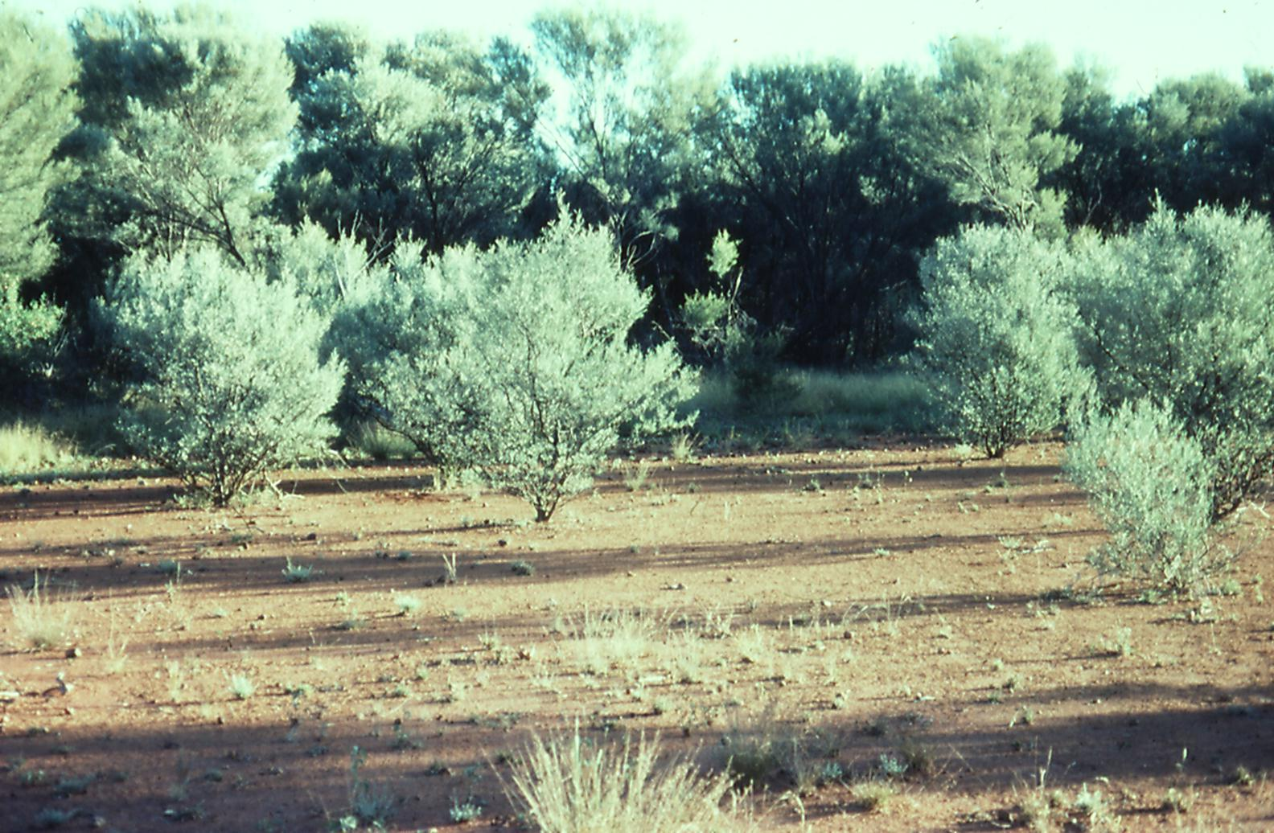
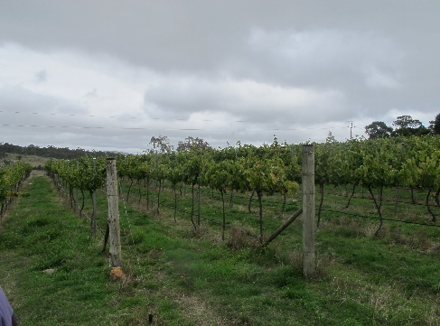
Limitations of using the van Genuchten model to fit soil water retention curves, in particular over restricted data ranges
Warren Müller, Environment, CSIRO, Canberra ACT | November 2023
Coauthors :
Richard Greene, ANU; Vilim Filipović, University of Queensland; James Noble, CSIRO (deceased)

Slide 2
Outline
What are Soil-Water Retention Curves?
Measurement of Soil Moisture Retention
The van Genuchten Model
Aims and Objectives
Experimental Sites
Results from Fitting the vG Model to Australian Data
Relationships over the Full Soil Moisture Range from Saturation to Oven Dry
Conclusions

Slide 3
What are Soil-Water Retention Curves?
Used by soil scientists in their studies of soil hydraulic properties
Describe soil water storage and hence water supply to plants
Shape depends on soil texture and soil structure
Different curves determined at different depths in a soil core
Expressed as the relationship between
Soil Volumetric Water Content and Soil Water Potential
(VWC) (h)
Usually a log scale is used for Soil Water Potential:
pF = log₁₀(h)
Often have a sigmoid shape
Different soils have different characteristic curves:

Slide 4
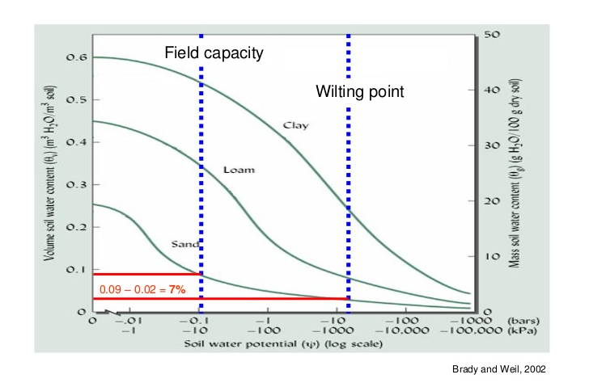
What are Soil-Water Retention Curves?
pF: 0 1 2 3 4 5 6

Slide 5
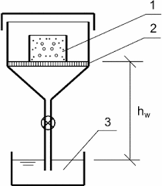
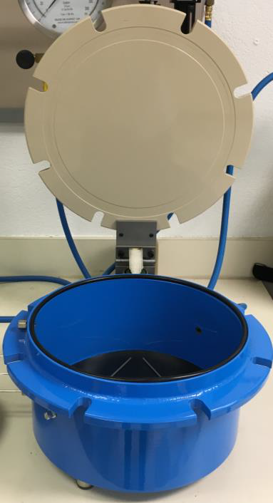
Measurement of Soil Moisture Retention
From saturation up to field capacity
From field capacity to wilting point:
PRESSURE CHAMBERS
1. Soil core 2. Semi-permeable membrane 3. Water reservoir
[California Department of Pesticide Regulation]
80-90% of moisture measurements still done using these methods

Slide 6
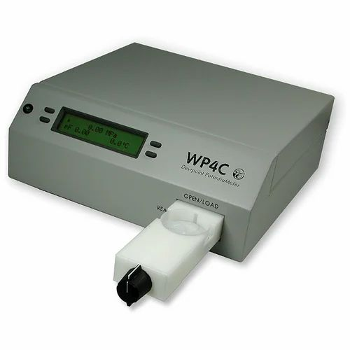
Measurement of Soil Moisture Retention
From wilting point to oven dry
Traditionally used complex and time-consuming methods
e.g. Campbell and Shiozawa 1992, Ross et al. 1991
Modern technology : WP4C
Can use over full range of soil moisture content
Ideal for soils drier than wilting point
Rapid measurement means many data points can be obtained for each curve

Slide 7
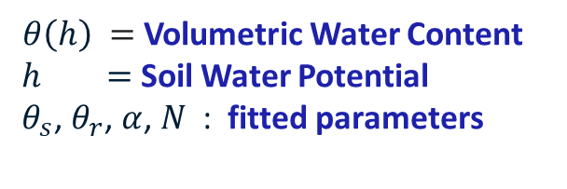
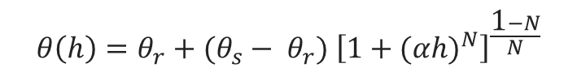
The van Genuchten Model
First published in 1980 by van Genuchten
Adopted widely in soil science as the model to use for water retention curves, often without critical thought
Often only 8 or 9 data points, due to effort required for each measurement
Used even when sigmoid shape is not apparent
$$θ\left(h\right)=θ_{r}+(θ_{s}− θ_{r}) {\left[1+{(αh)}^{N}\right]}^{\frac{\text{1}−N}{N}}$$
$θ\left(h\right) =$ Volumetric Water Content
$h =$ Soil Water Potential
${ θ}_{s}$, $θ_{r}$, $α$, $N$ : fitted parameters

Slide 8
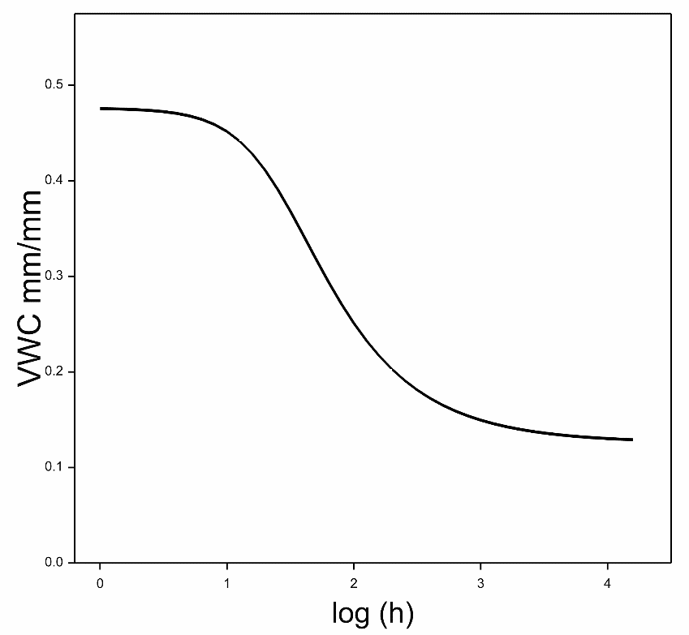
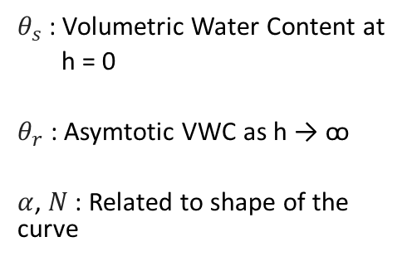

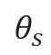
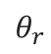
The van Genuchten Model
$$θ\left(h\right)=θ_{r}+(θ_{s}− θ_{r}) {\left[1+{(αh)}^{N}\right]}^{\frac{\text{1}−N}{N}}$$
$θ_{s}$ : Volumetric Water Content at
h = 0
$θ_{r}$ : Asymtotic VWC as h → ꝏ
$α$, $N$ : Related to shape of the curve
$$θ_{s}$$
$$θ_{r}$$
pF =

Slide 9
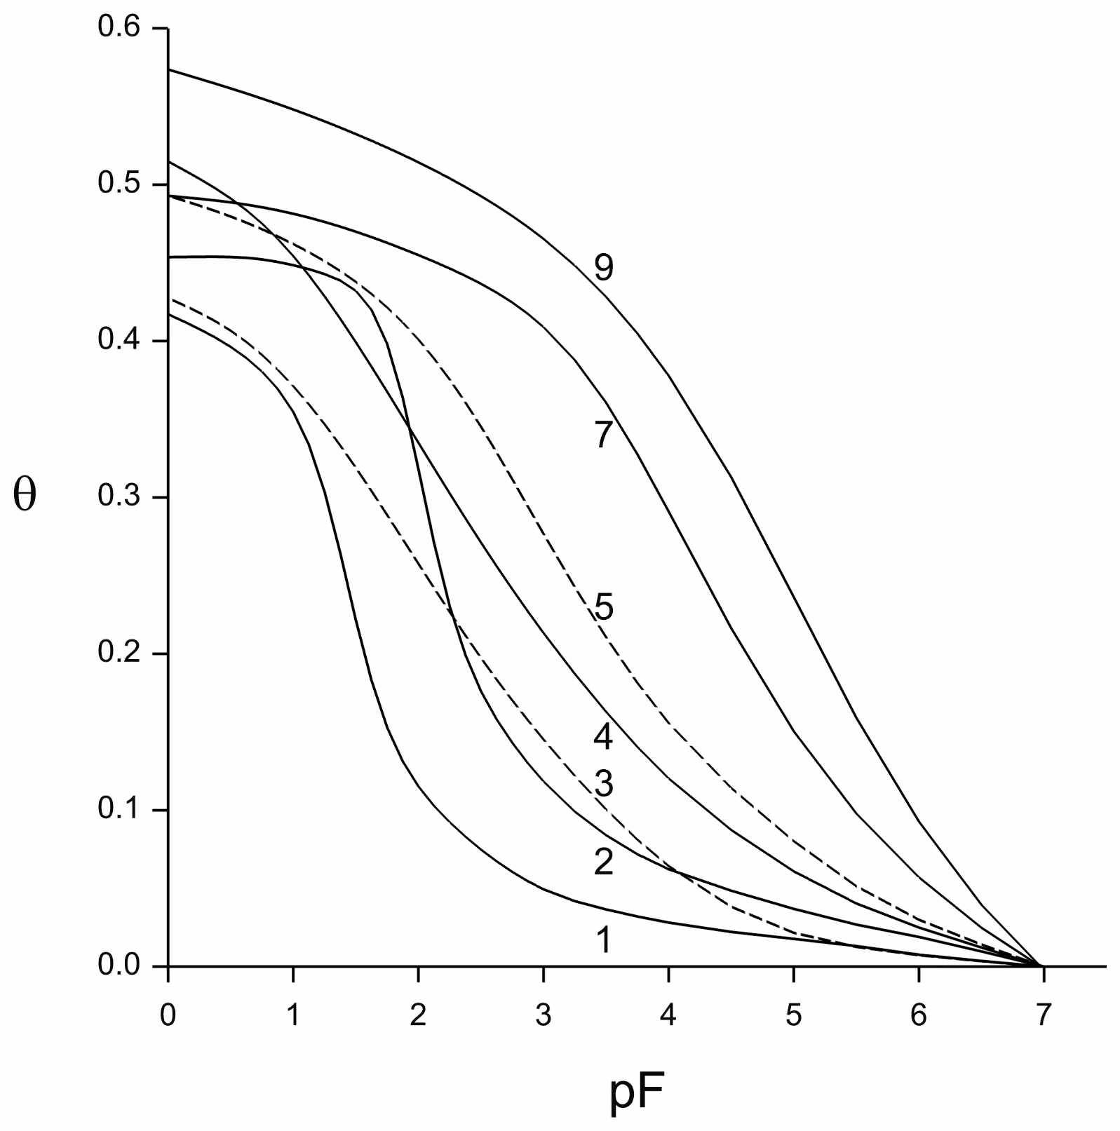
Typical Soil Moisture Retention Curves
Dutch soils
Dune sand;
Loamy sand;
Calcareous fine sandy loam;
Calcareous loam;
Silt loam derived from loess;
Marine clay;
River basin clay.
(Data: ICW, Wageningen.).
Omitted: two peat soils (6 and 8)
Vertical dotted lines:
wilting point, pF = 4.176
field capacity, pF = 2
Field capacity Wilting point
Fig 3.12 from Koorevaar et al. 1983 “Elements of Soil Physics” (with axes transposed)

Slide 10
Aims and Objectives
To critically examine the applicability of the van Genuchten equation to soil moisture measurements on Australian soils, using data from two different soil management regimes
To use the Australian data to understand the properties of the parameters in the van Genuchten model and the relationships between them
To use historic international data to determine the effect on parameter estimation of only fitting data over a restricted pF range

Slide 11

Experimental Sites
Semi-arid rangelands: 6 sites x 6 samples
(1 missing)
35 samples
Yass Valley vineyard:
1 site
2 pits
3, 4 depths from the pits
7 samples
Semi-arid sites
•
Sydney
Yass Valley site •
Melbourne

Slide 12
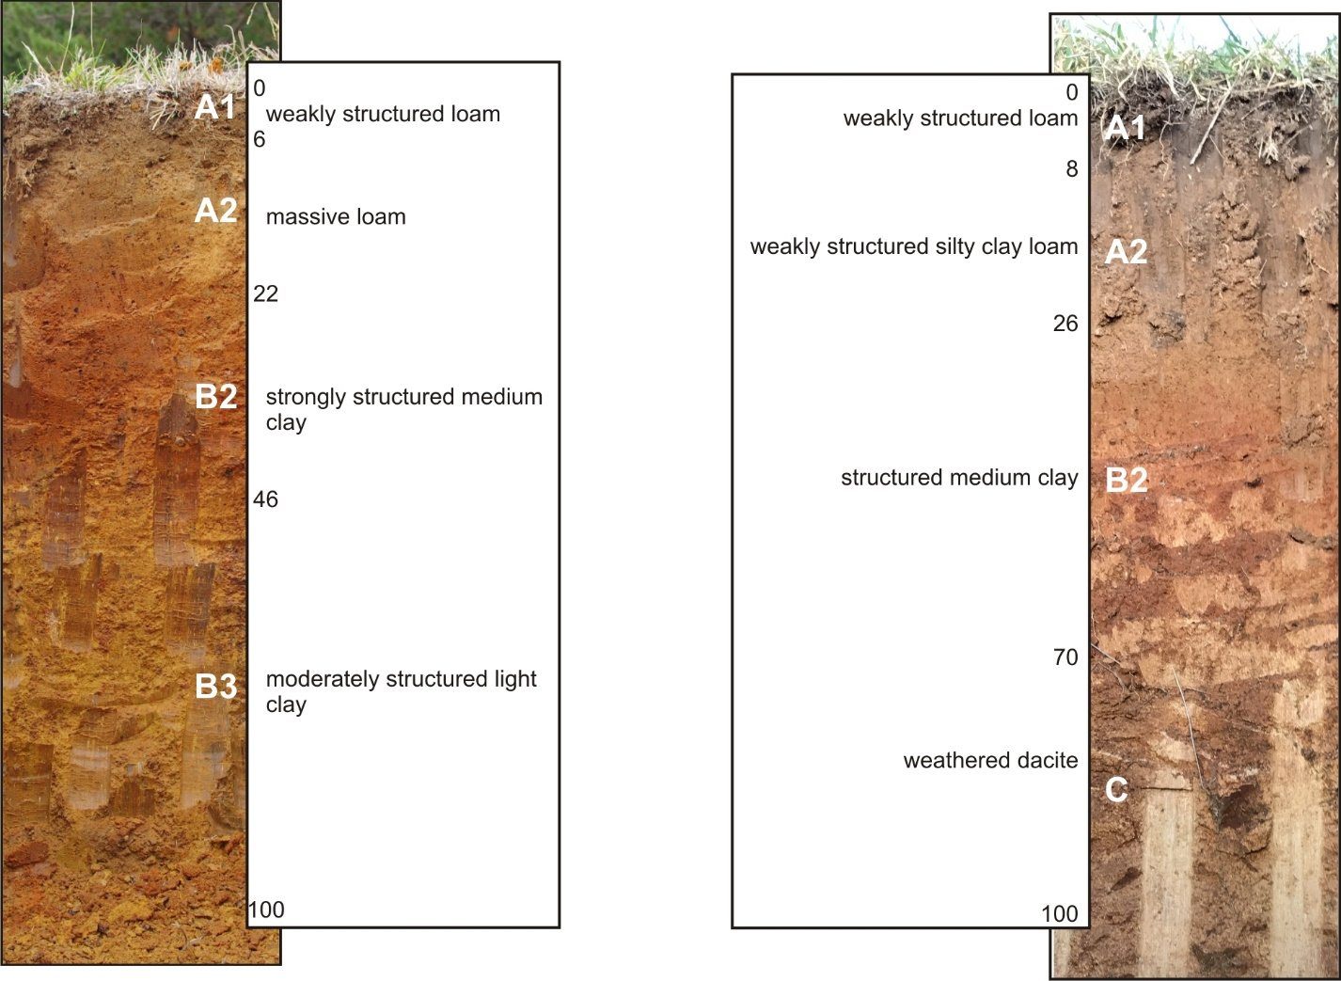
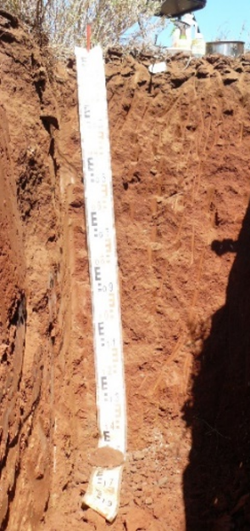
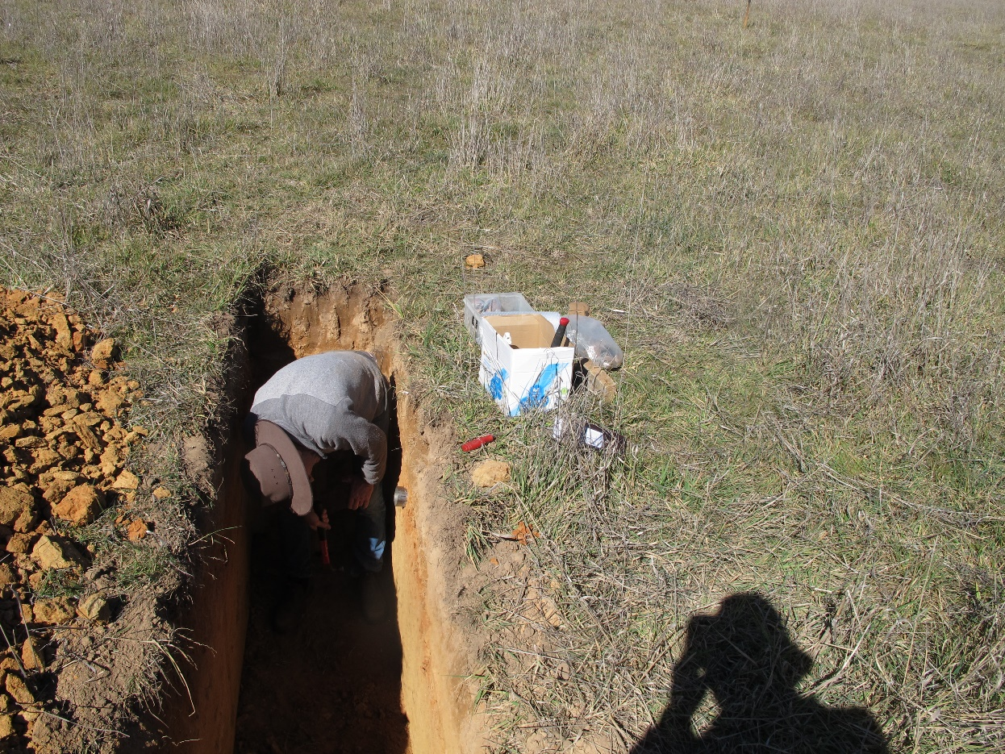
Experimental Sites
Rangelands profile
Yass Valley vineyard profile
Loamy soil
Sharp change from loam to clay

Slide 13
Results from Fitting Australian Data
Examples of Rangelands Sites Fitted Parameters

Slide 14
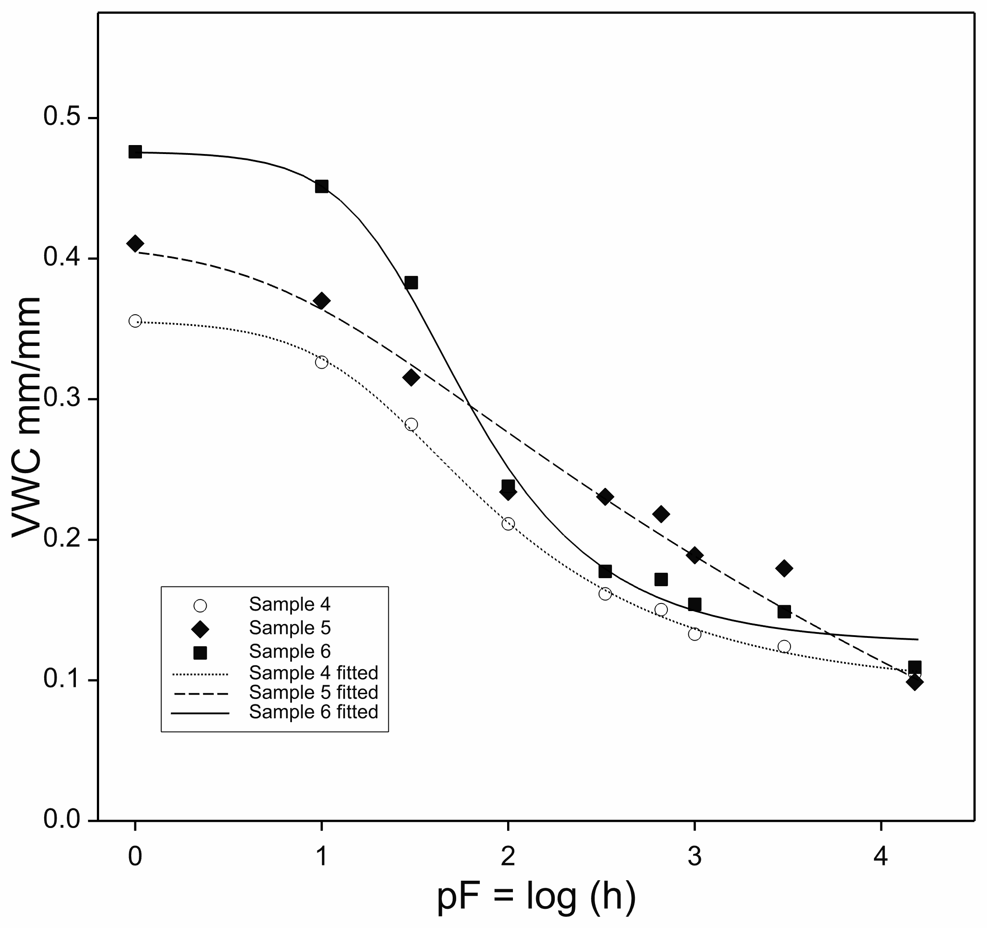
Results from Fitting Australian Data
Rangelands Site 3 Observations and Fitted Curves

Slide 15
Results from Fitting Australian Data
Vineyard Site Fitted Parameters
Curve fitting was unstable for samples 2 and 3

Slide 16
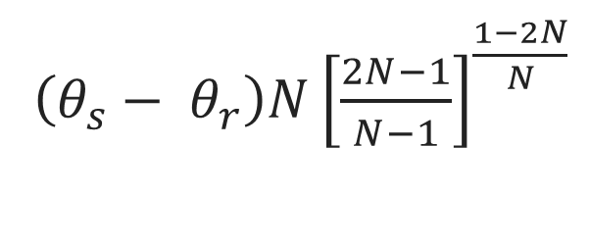
Results from Fitting Australian Data
Derived Parameters
Investigated several derived parameters
Only useful one was
Maximum slope of VWC vs log (h)
[point of inflexion for sigmoid curve]
$\left(θ_{s}− θ_{r}\right)N{\left[\frac{2N−1}{N−1}\right]}^{\frac{1−2N}{N}}$

Slide 17
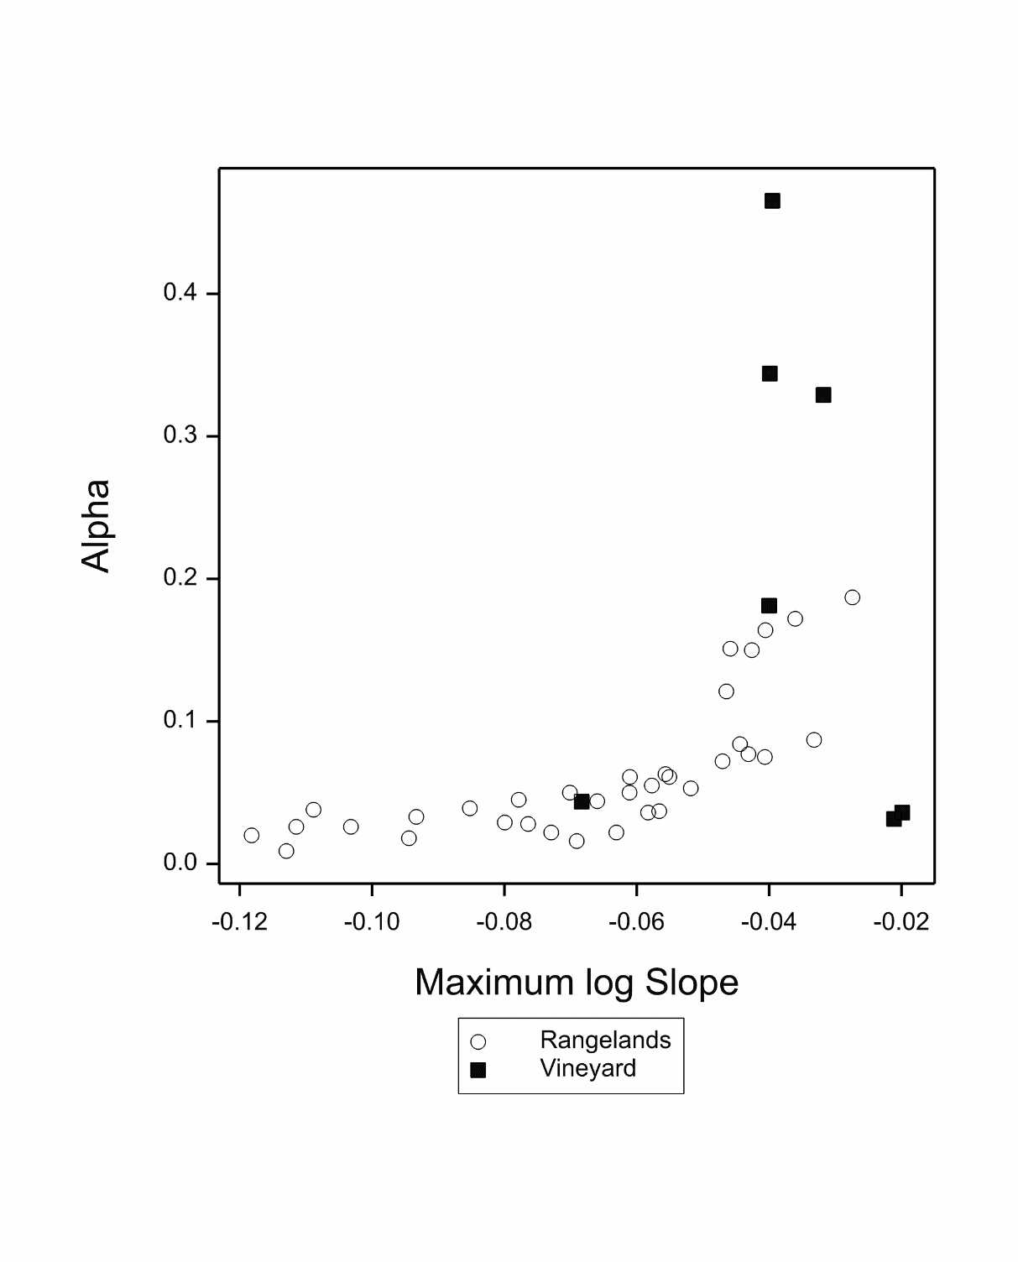
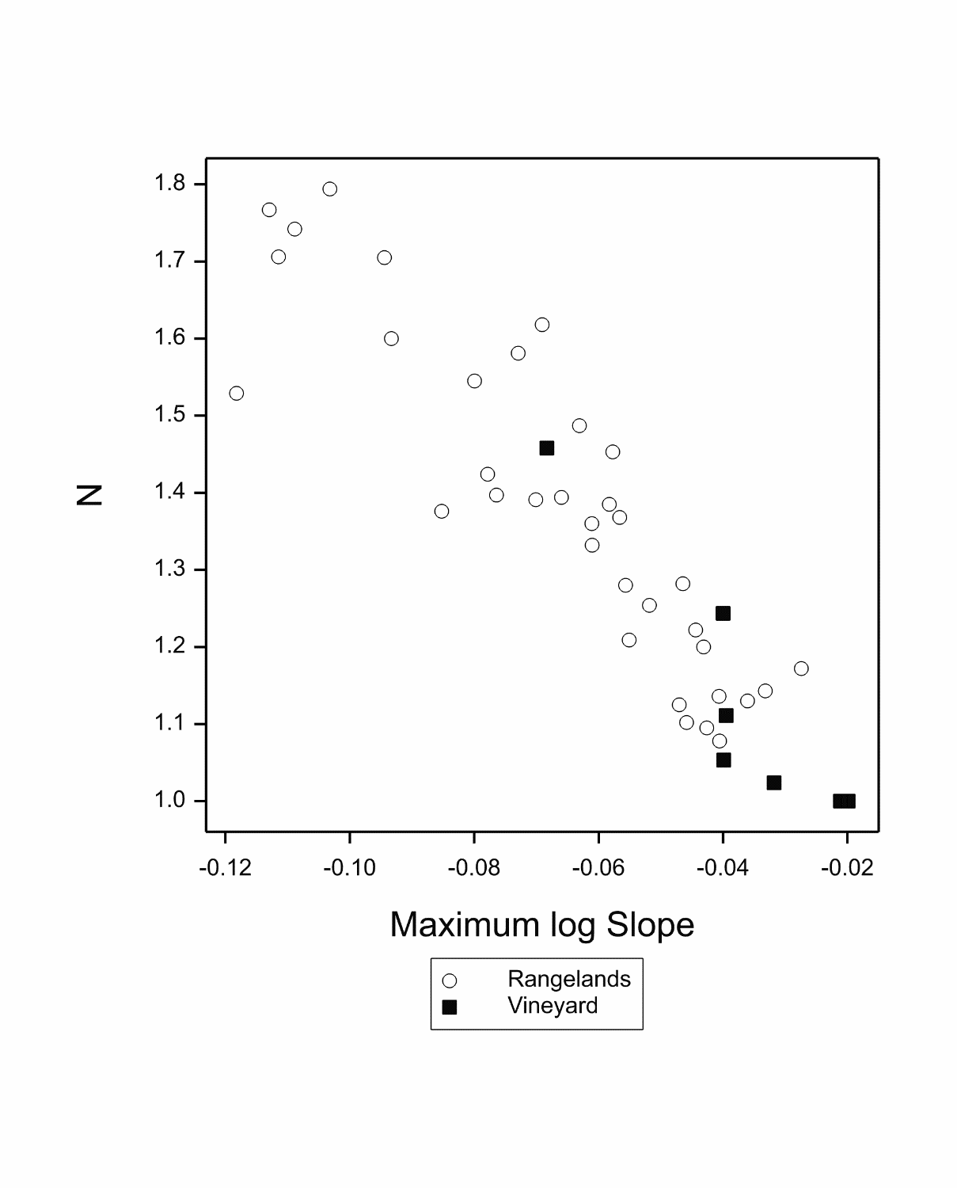
Results from Fitting Australian Data
Relationships between Parameters

Slide 18
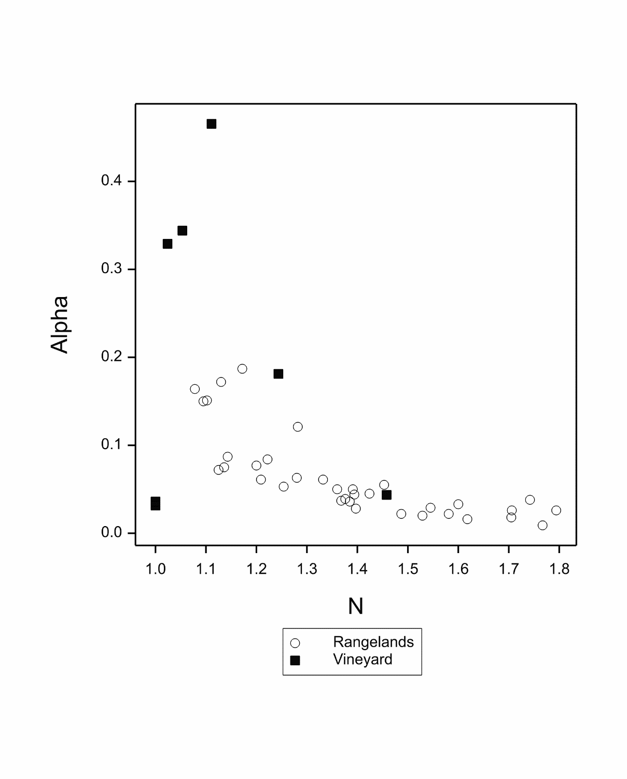
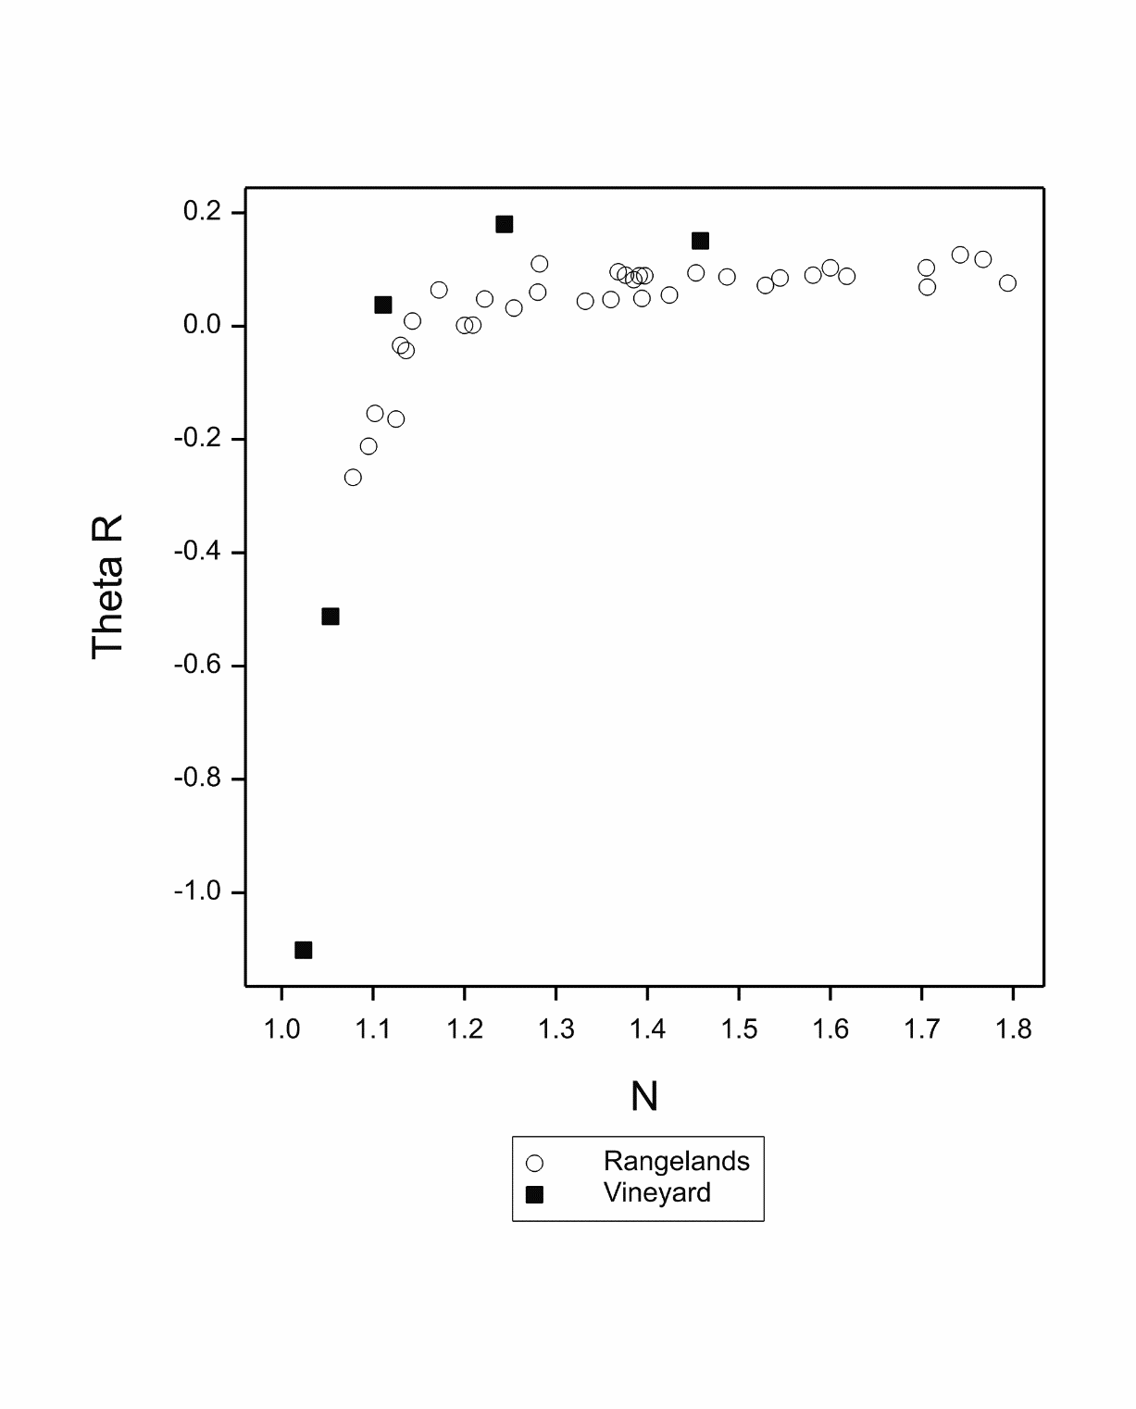
Results from Fitting Australian Data
Relationships between Parameters

Slide 19
Relationships over the Full Soil Moisture Range
Wilting point is defined as occurring when Soil Water Potential (h) = 15000, i.e. pF = 4.176
All the previous relationships were developed on data with pF < 4.176
To test what happens when pF > 4.176 we searched for datasets over the wider range
TWO MAJOR SOURCES
Datasets ‘Palouse B’, ‘Palouse A’, ‘Royal’ used by Ross, Williams and Bristow (1991) and Campbell and Shiozawa (1992)
Several datasets from the ‘UNSODA’ database with one of more observations where pF > 4.176

Slide 20
Relationships over the Full Soil Moisture Range
PALOUSE B, PALOUSE A, ROYAL
Fitted van Genuchten Parameters for Two pF Ranges

Slide 21
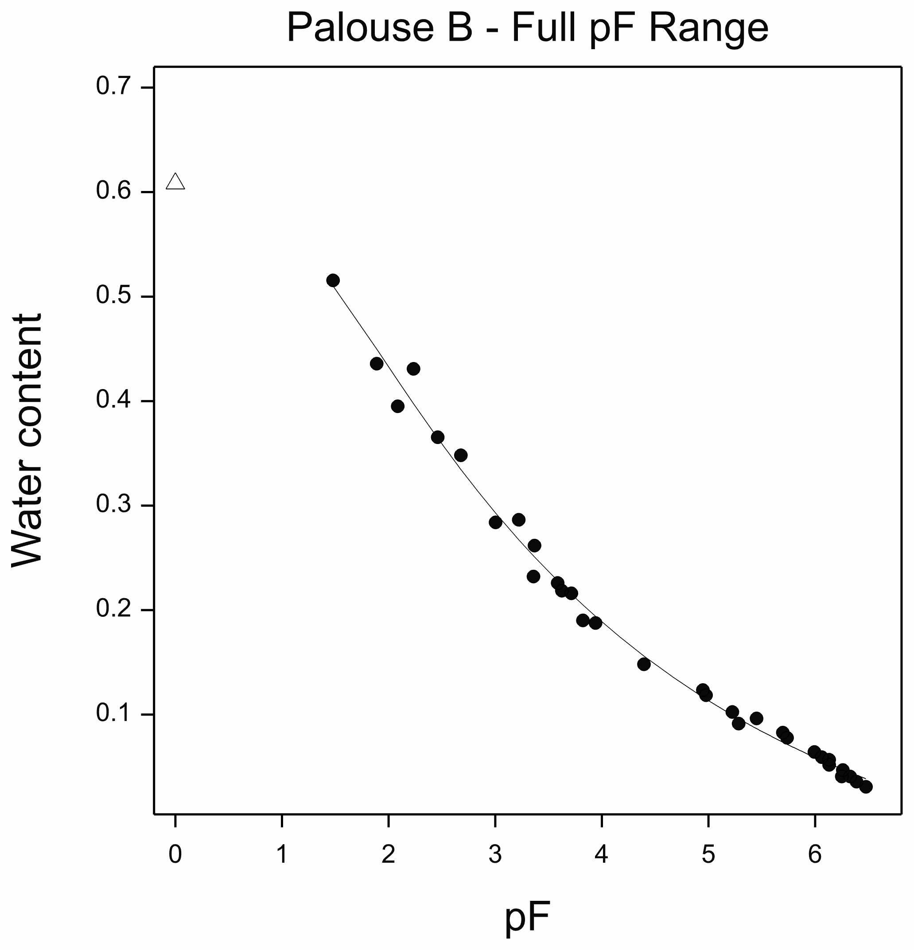
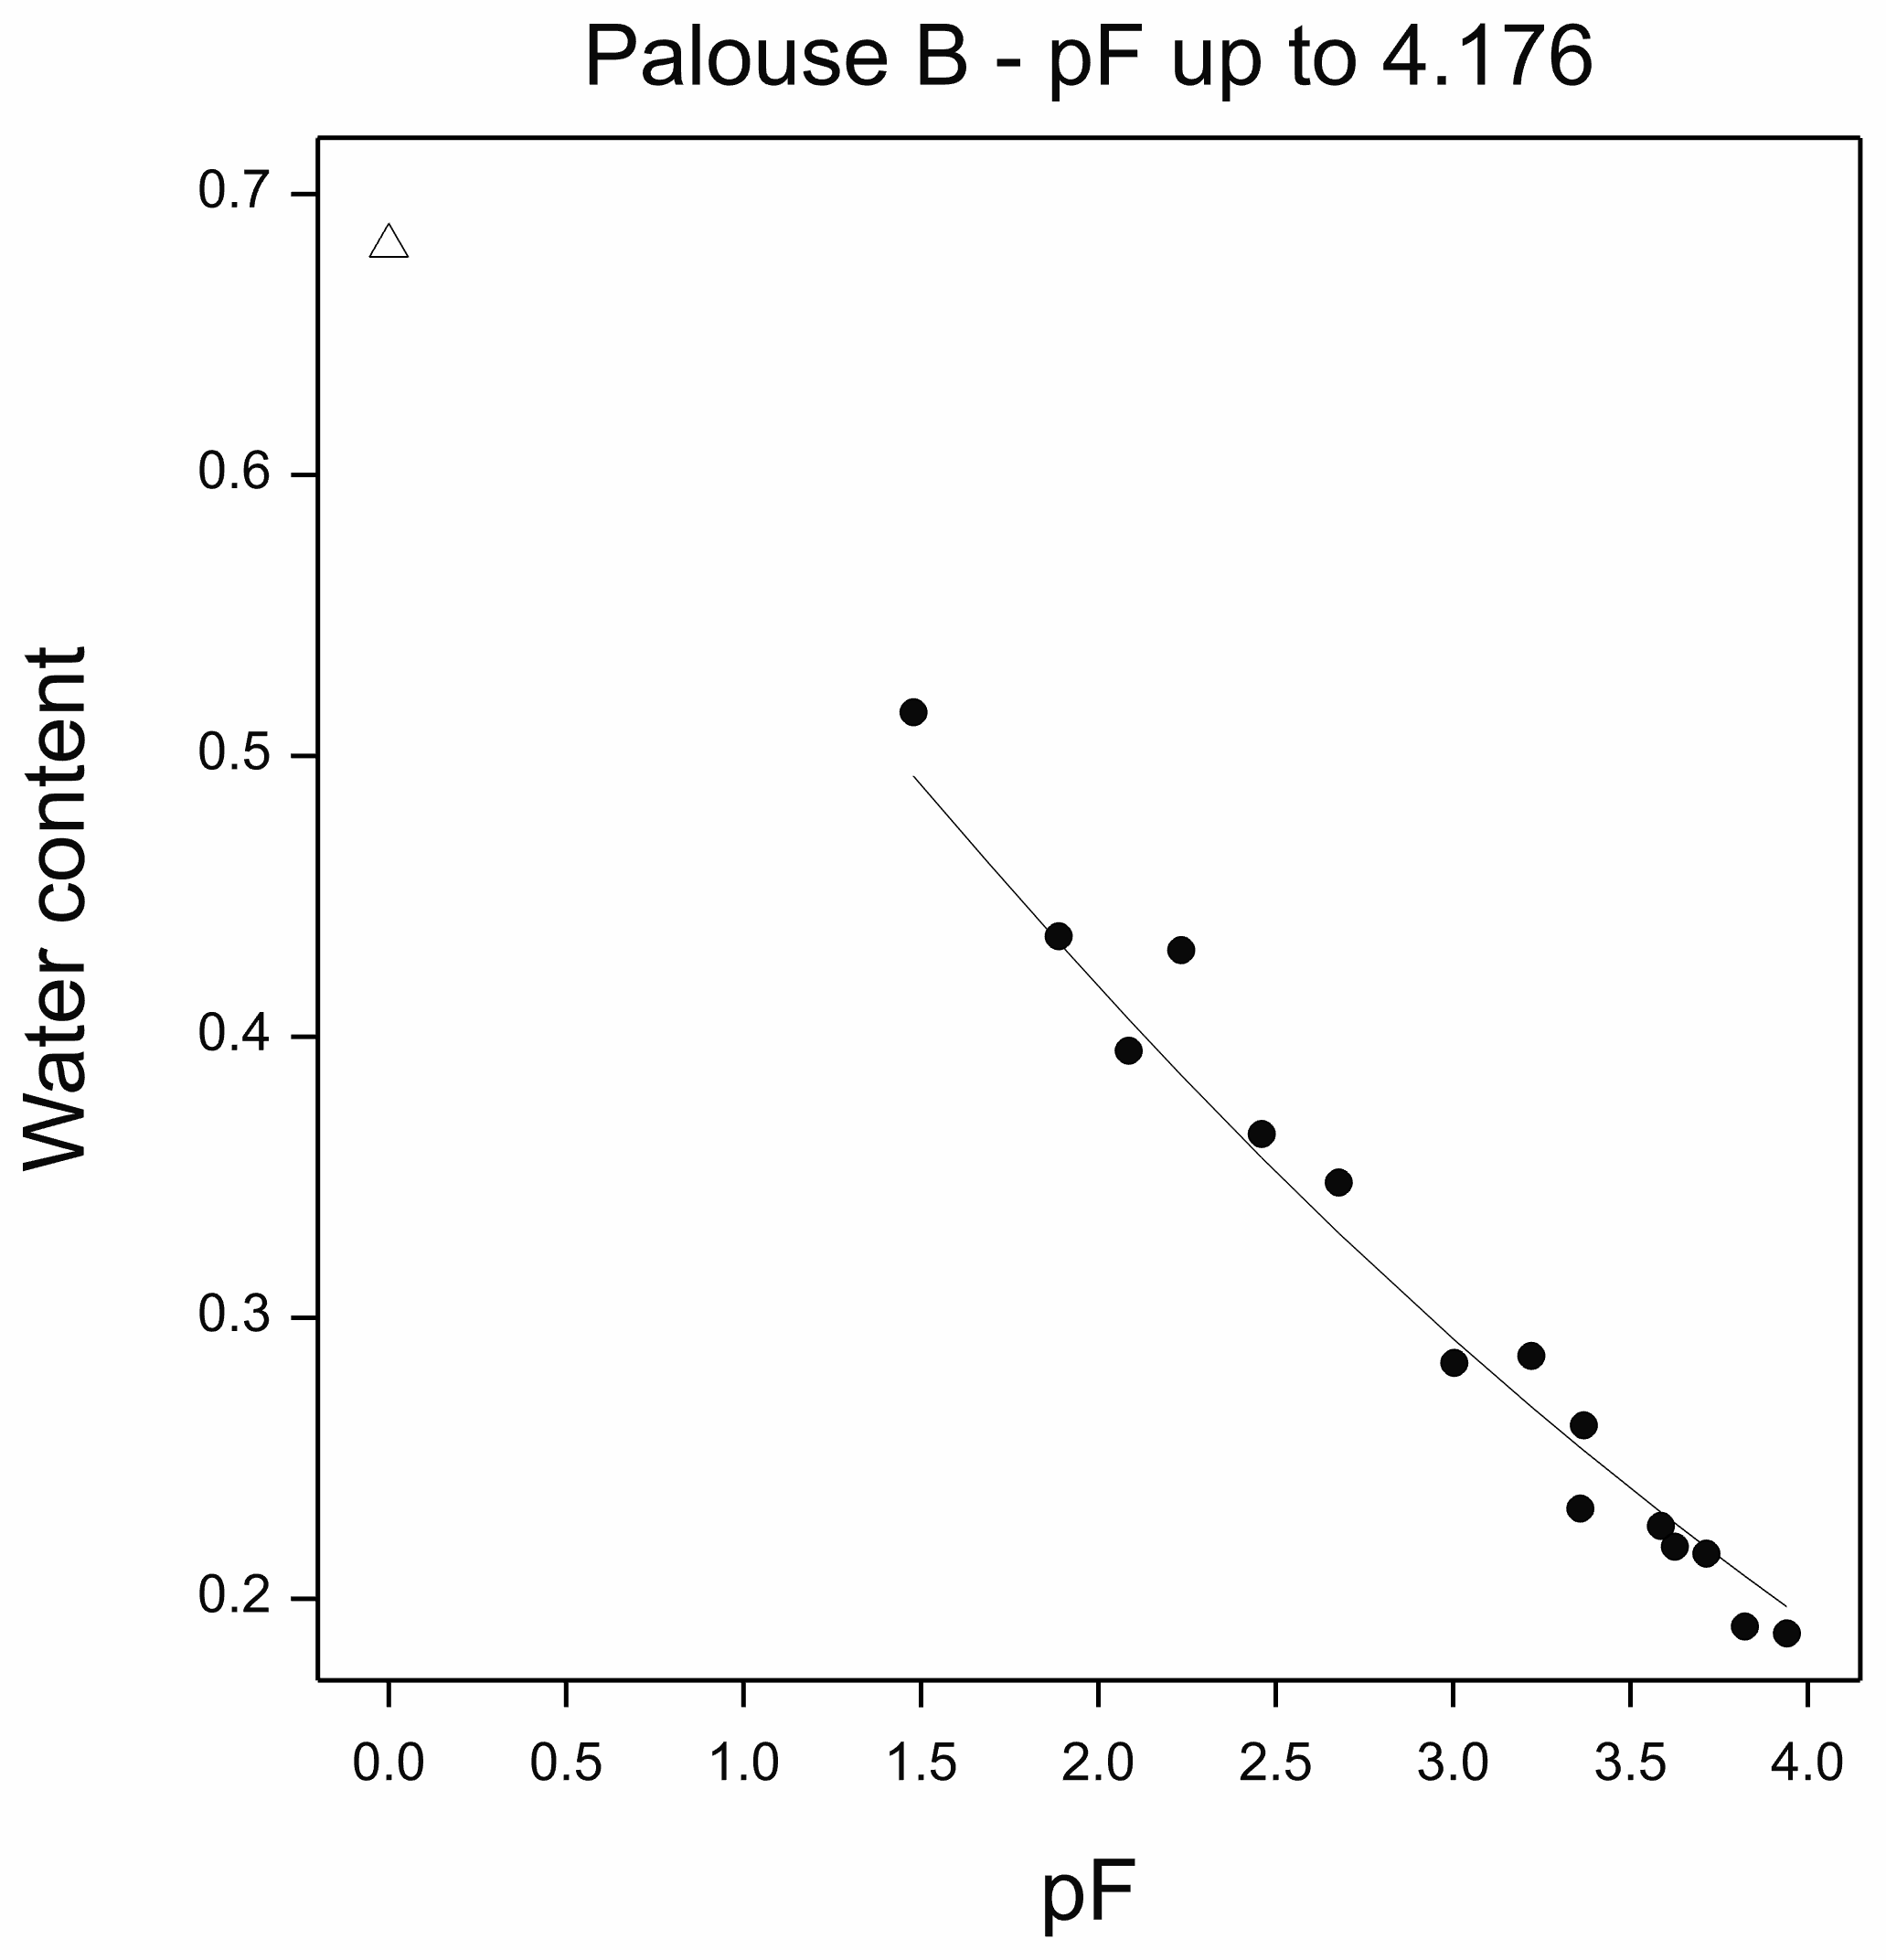
Relationships over the Full Soil Moisture Range
PALOUSE B

Slide 22
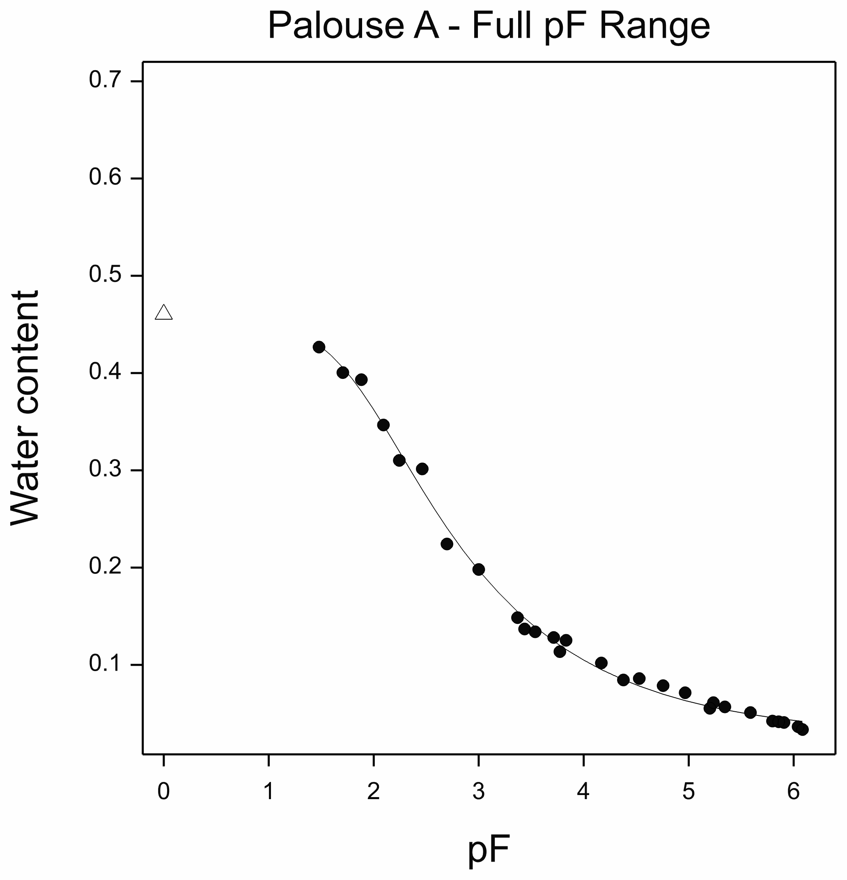
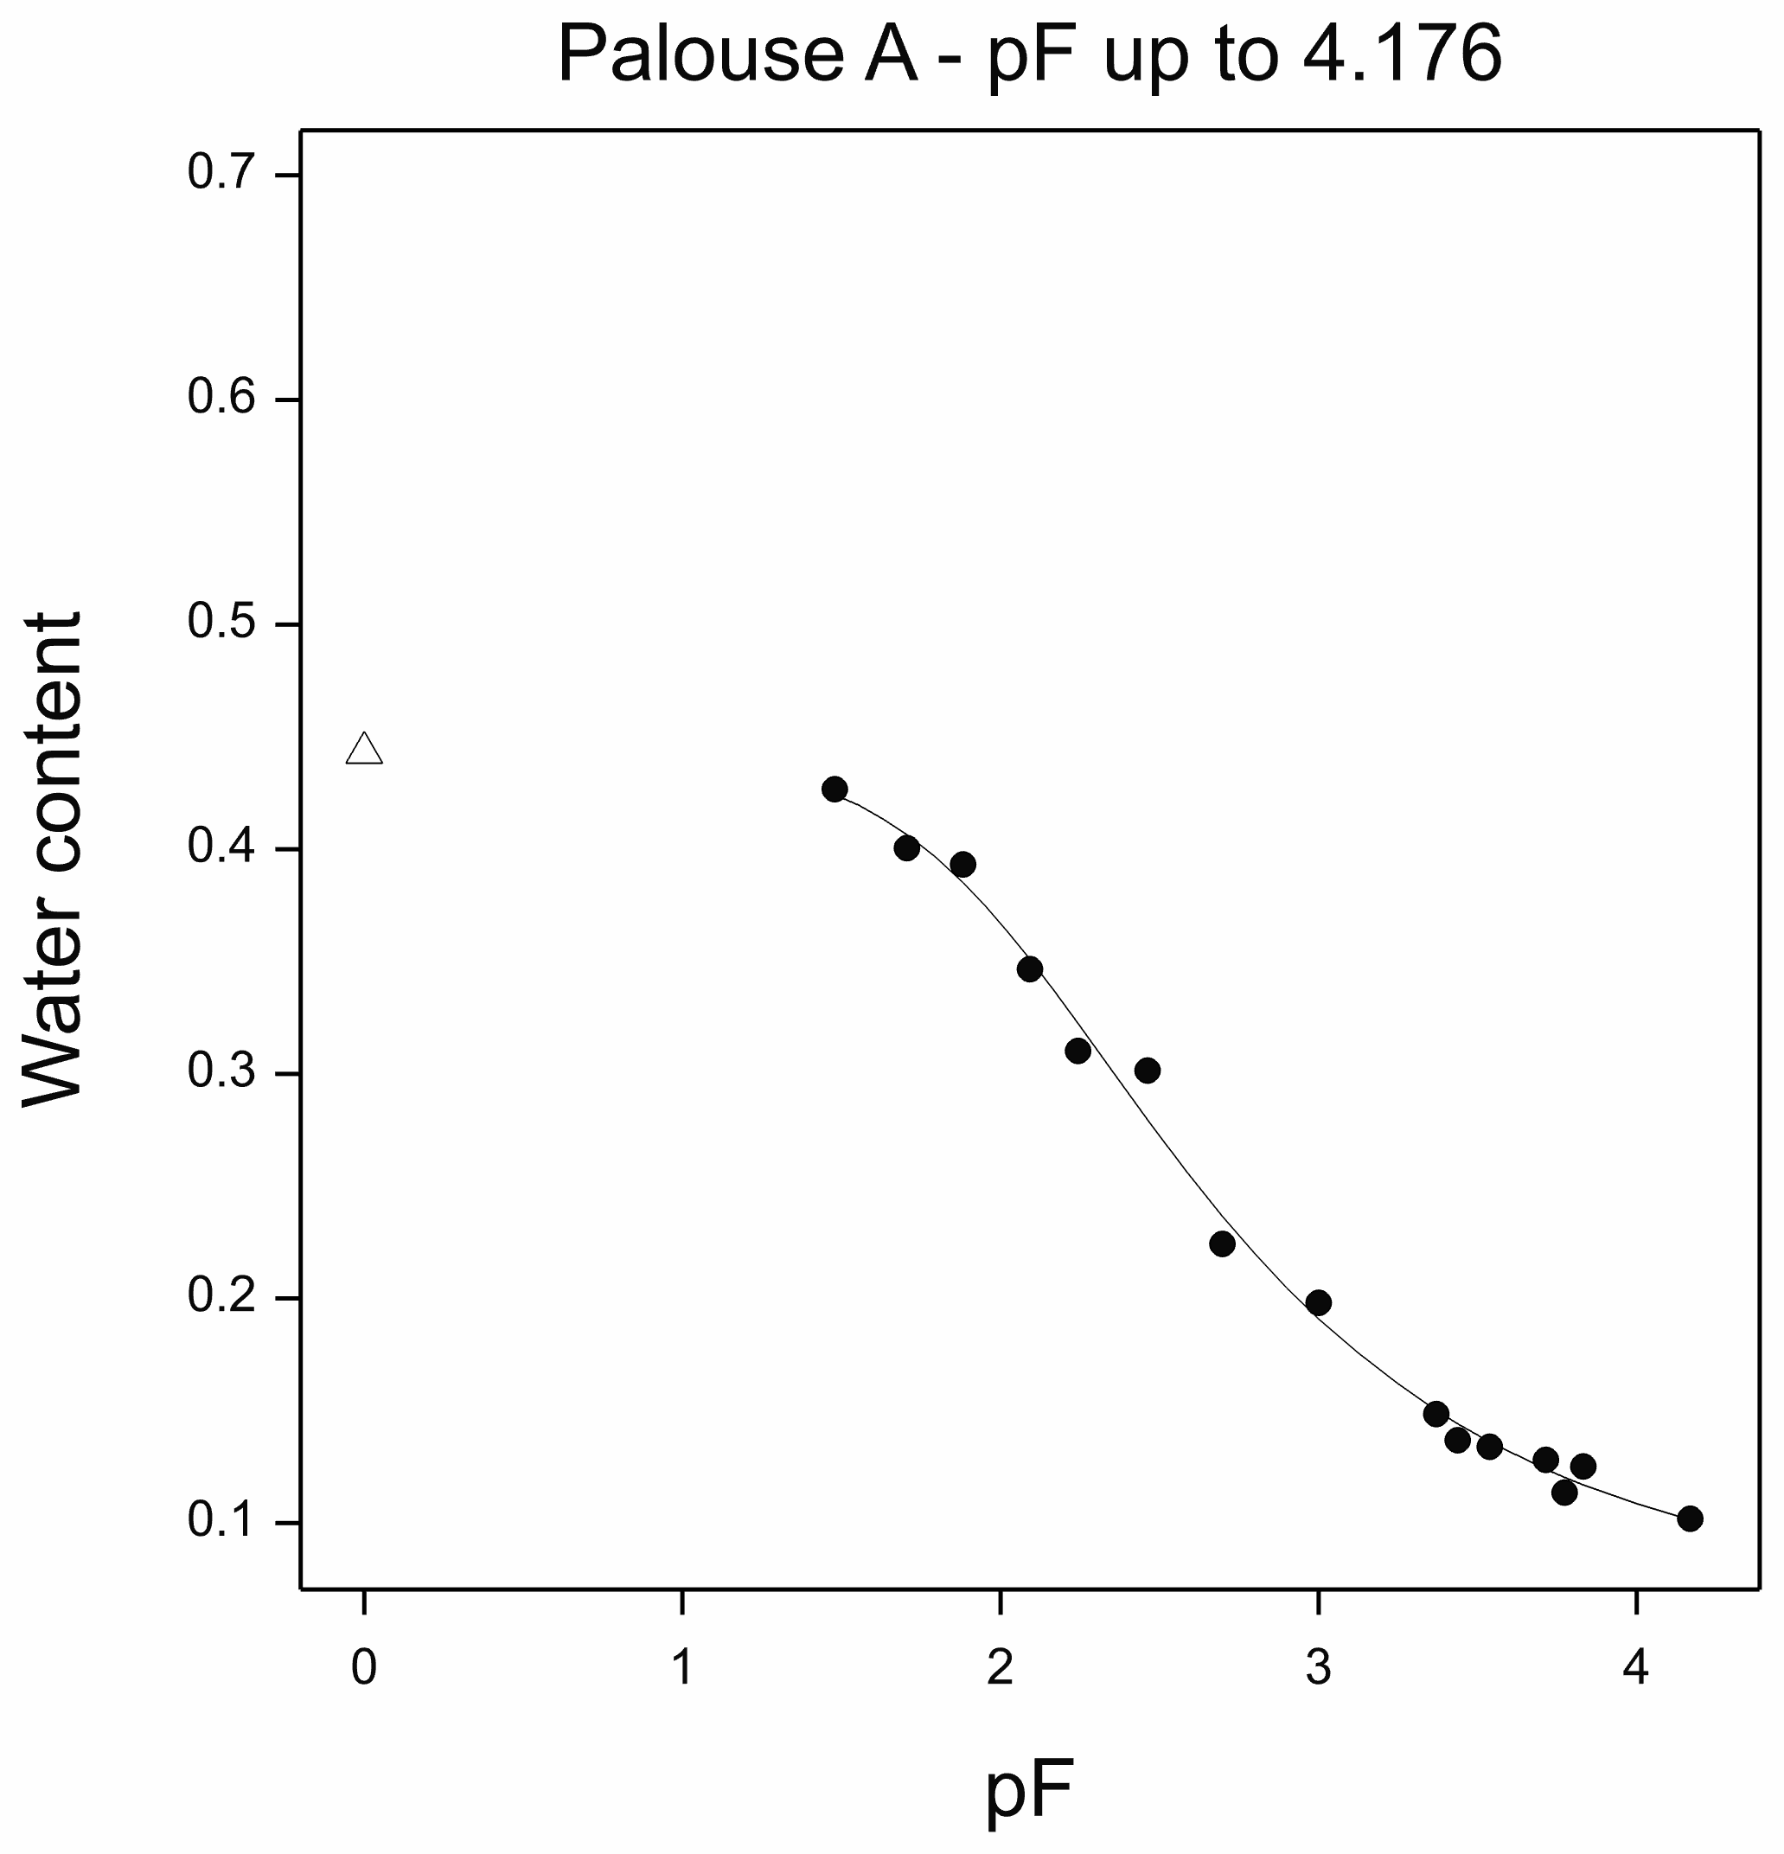
Relationships over the Full Soil Moisture Range
PALOUSE A

Slide 23
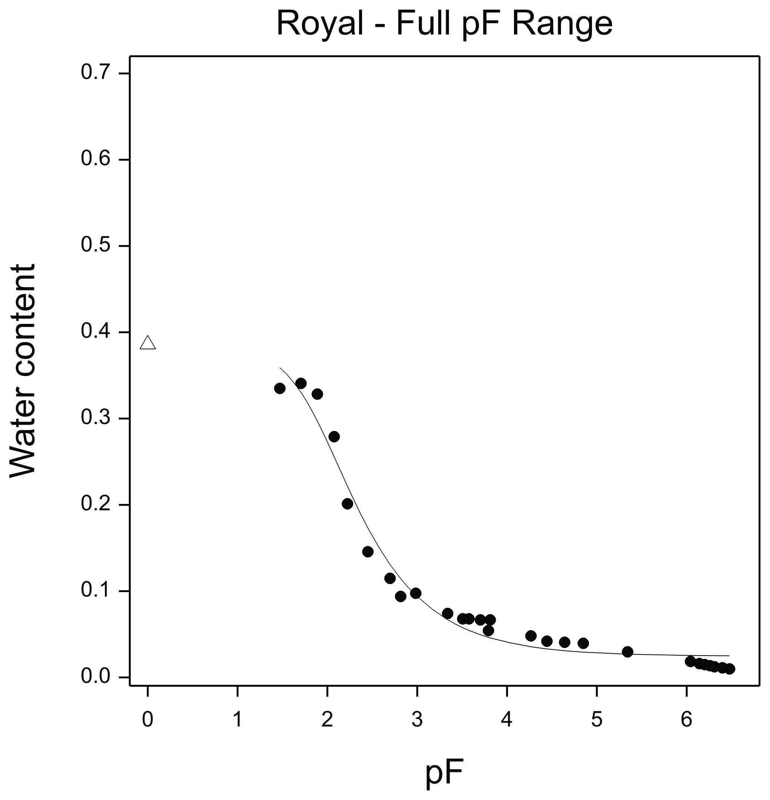
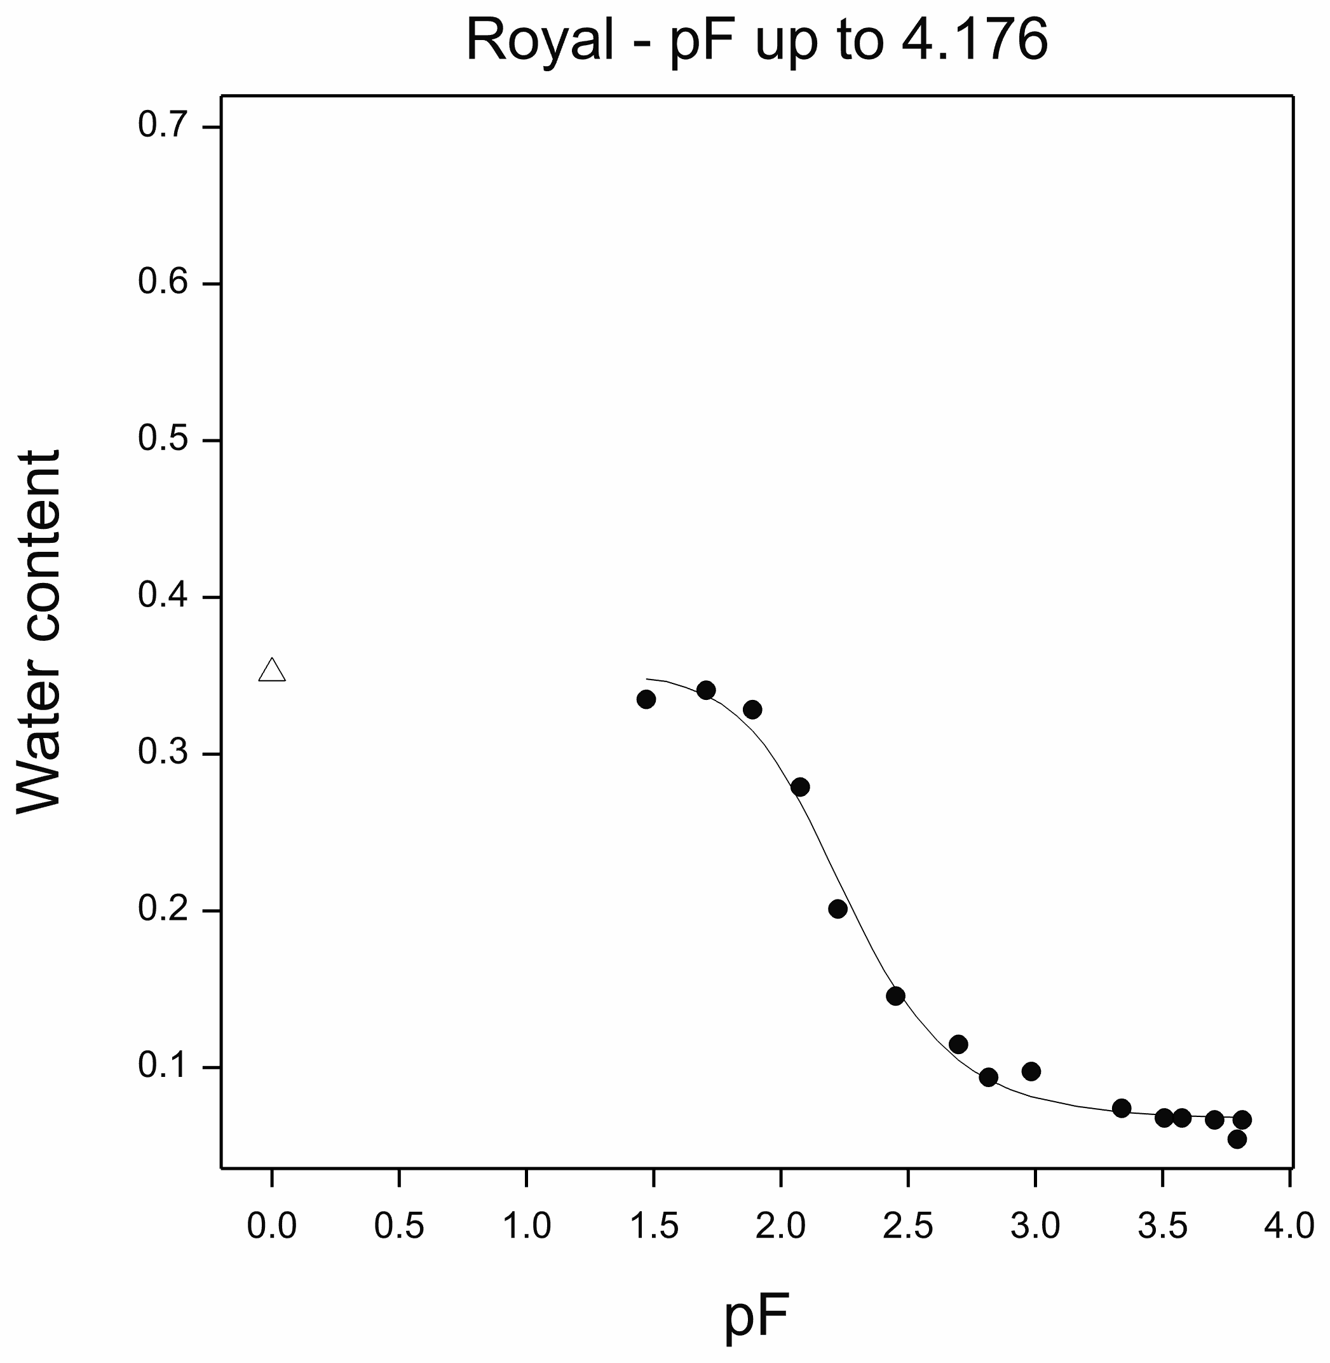
Relationships over the Full Soil Moisture Range
ROYAL

Slide 24
Relationships over the Full Soil Moisture Range
UNSODA DATASETS
Fitted van Genuchten Parameters for Two pF Ranges

Slide 25
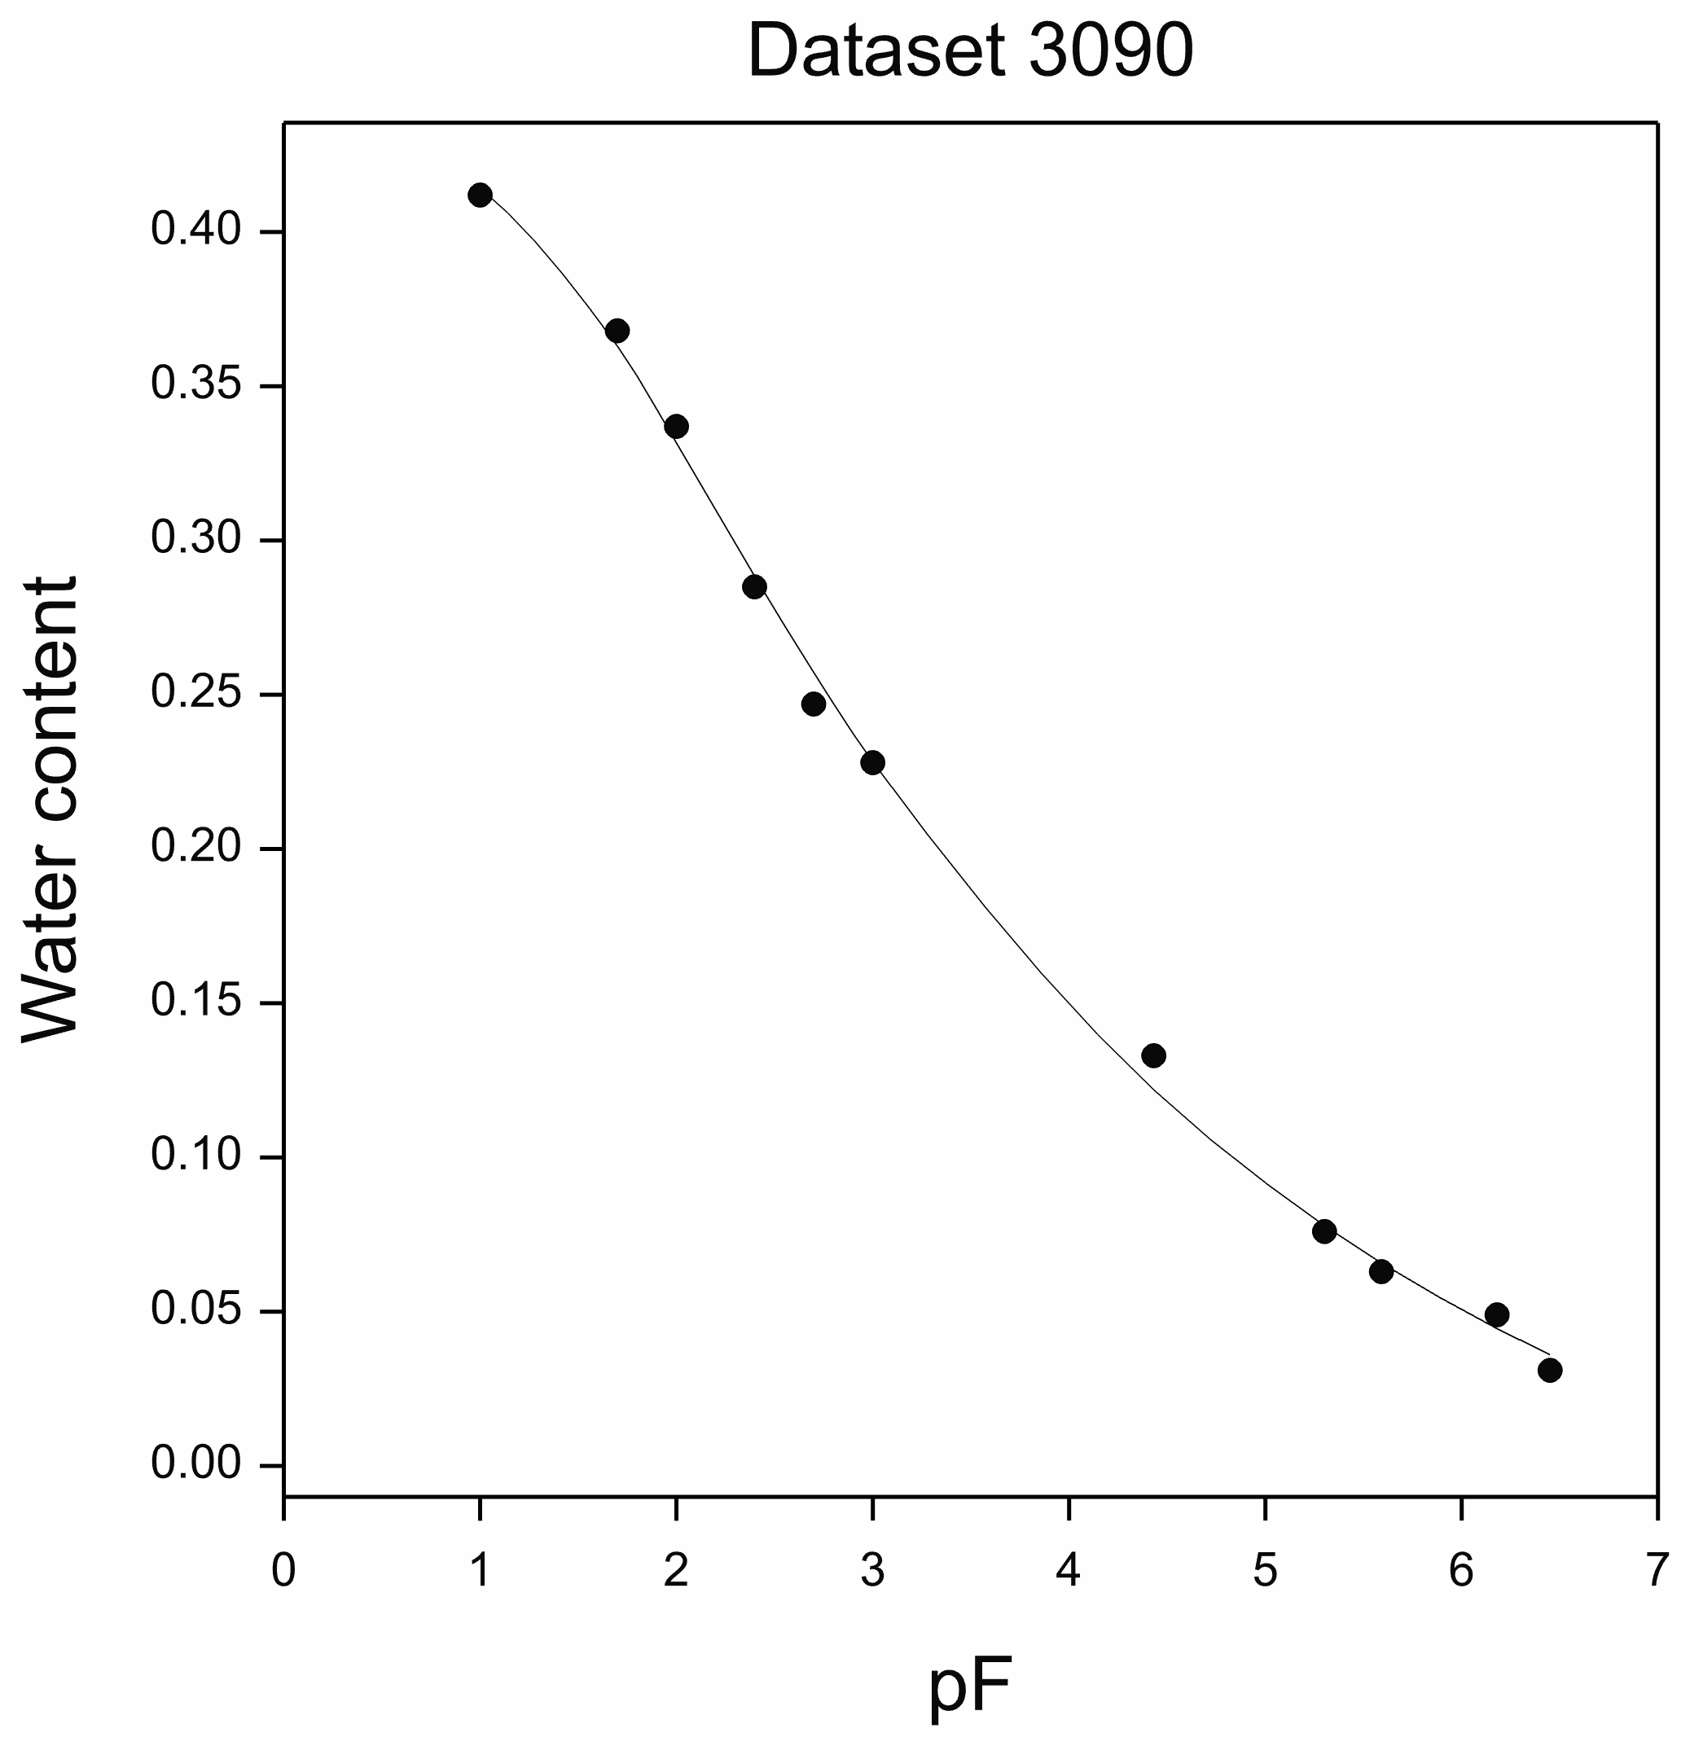
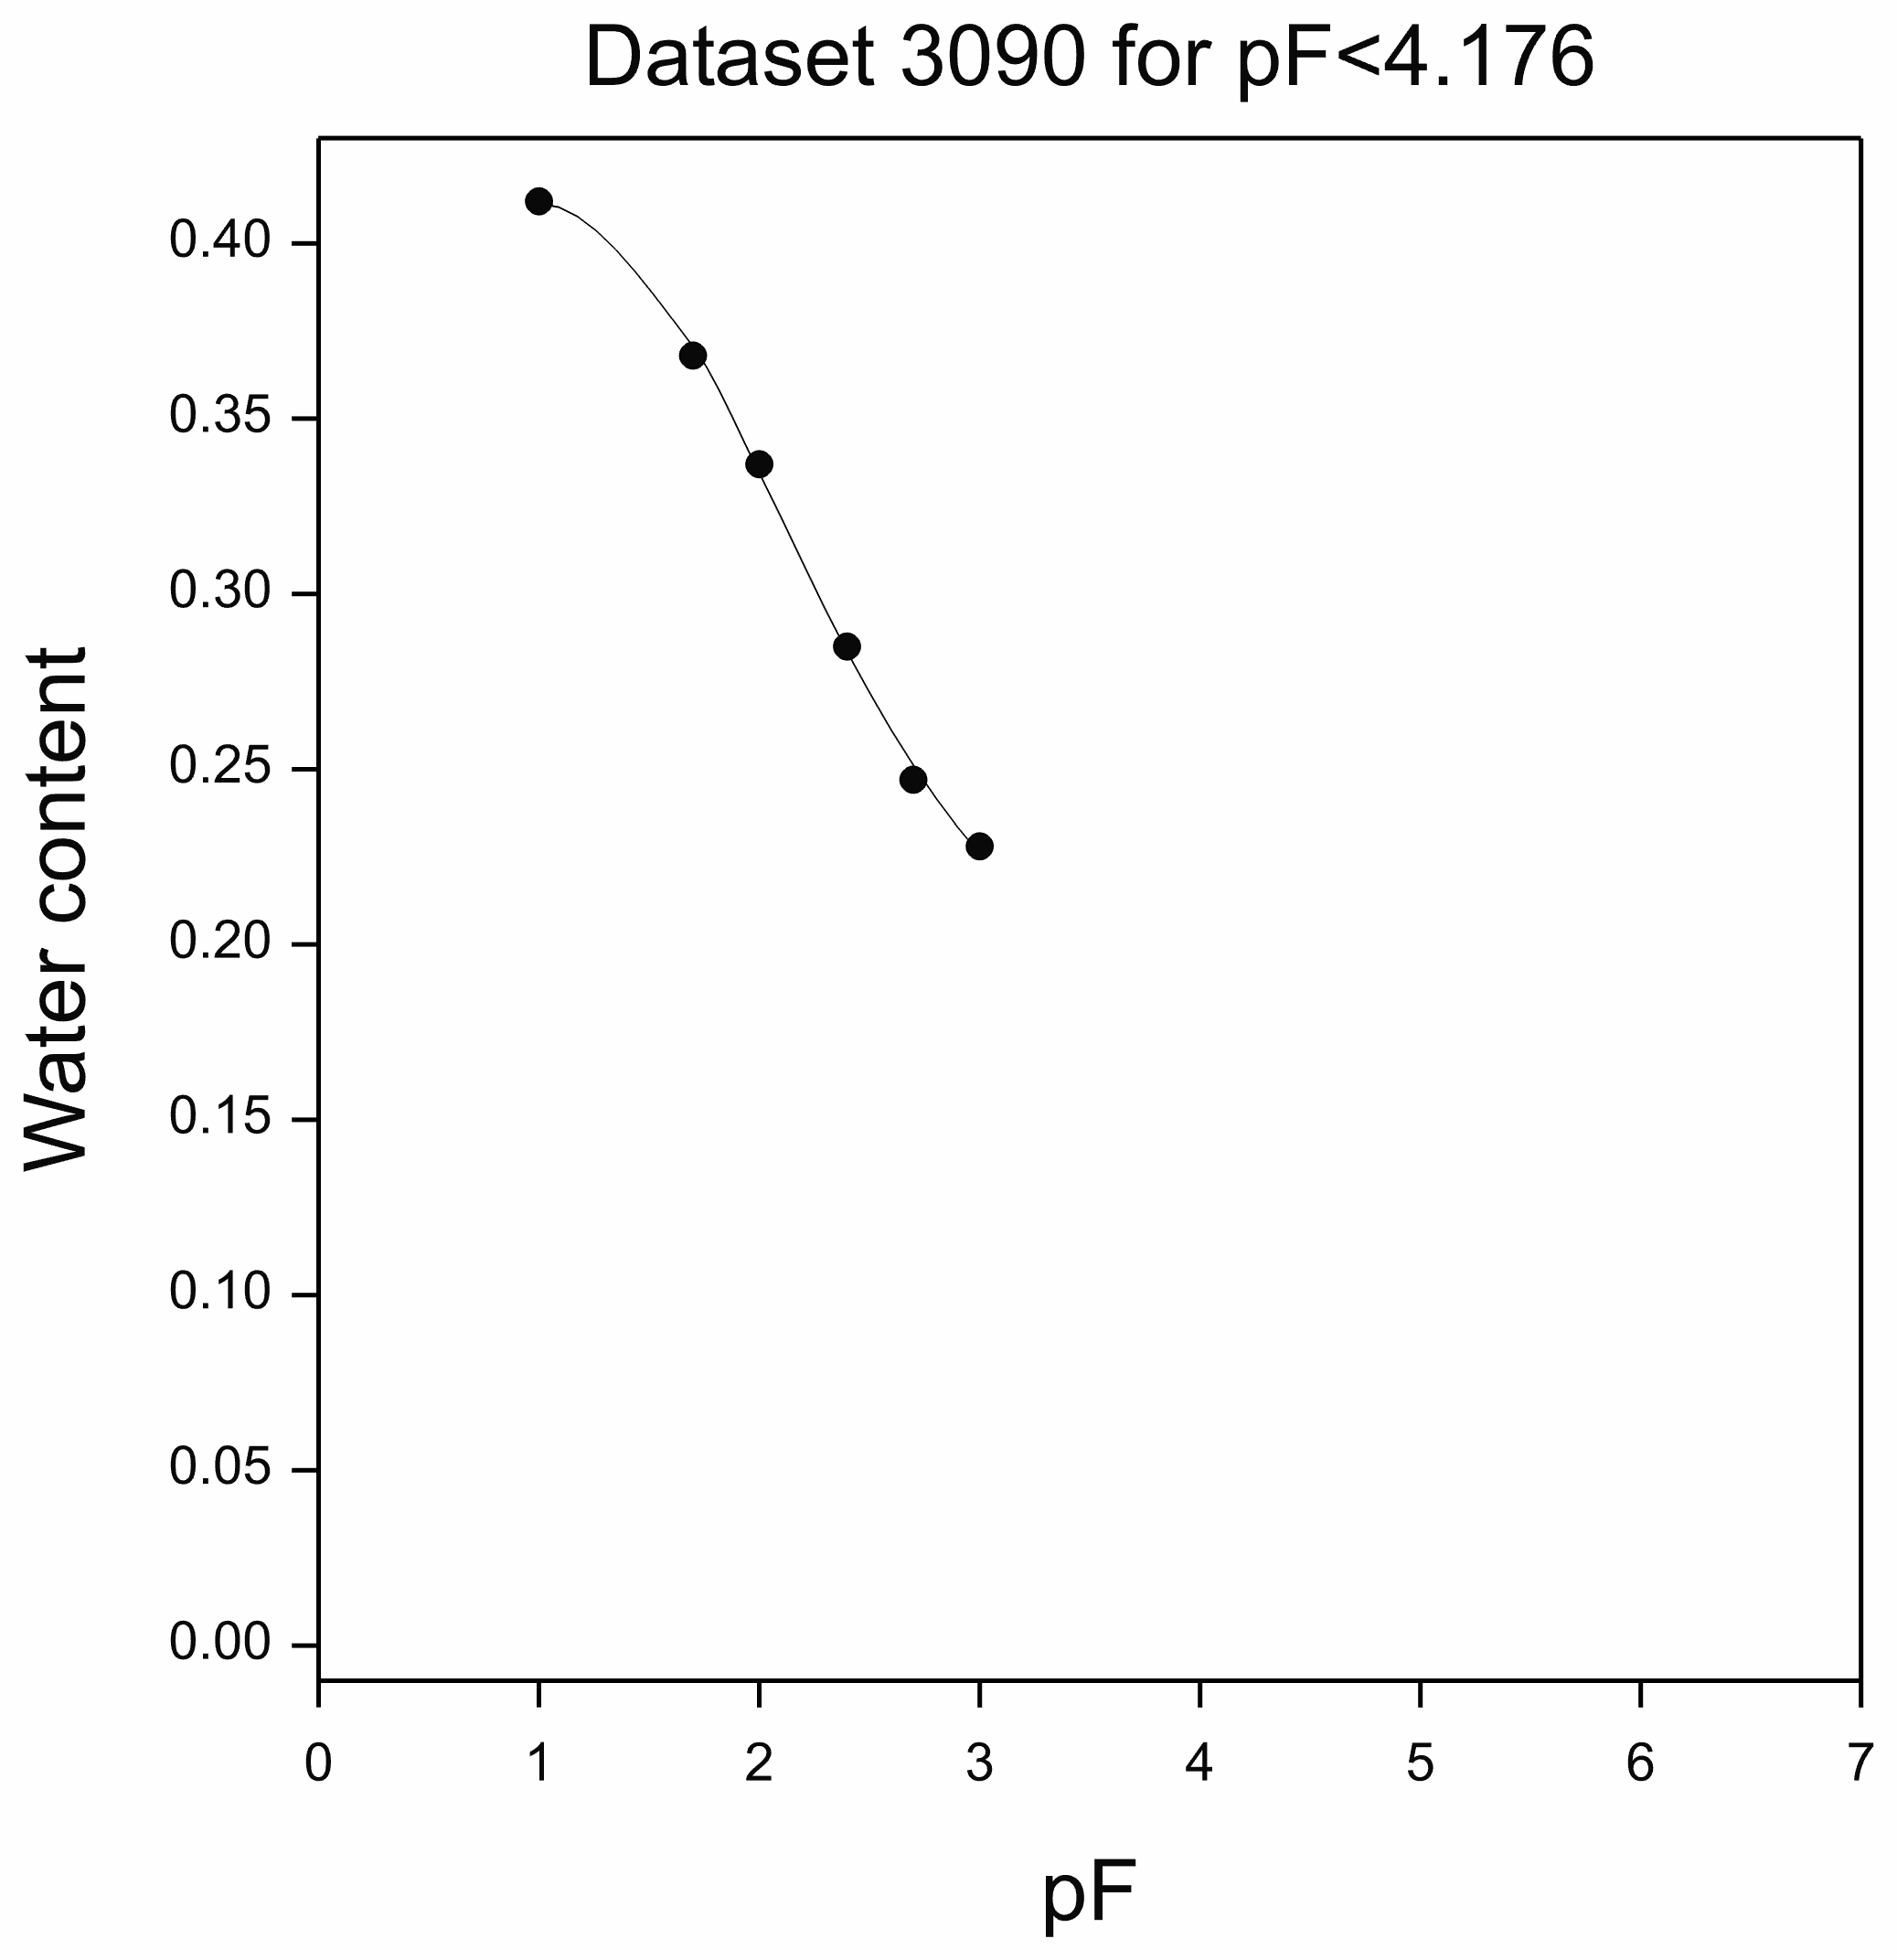
Relationships over the Full Soil Moisture Range
UNSODA DATASETS
Silt loam

Slide 26
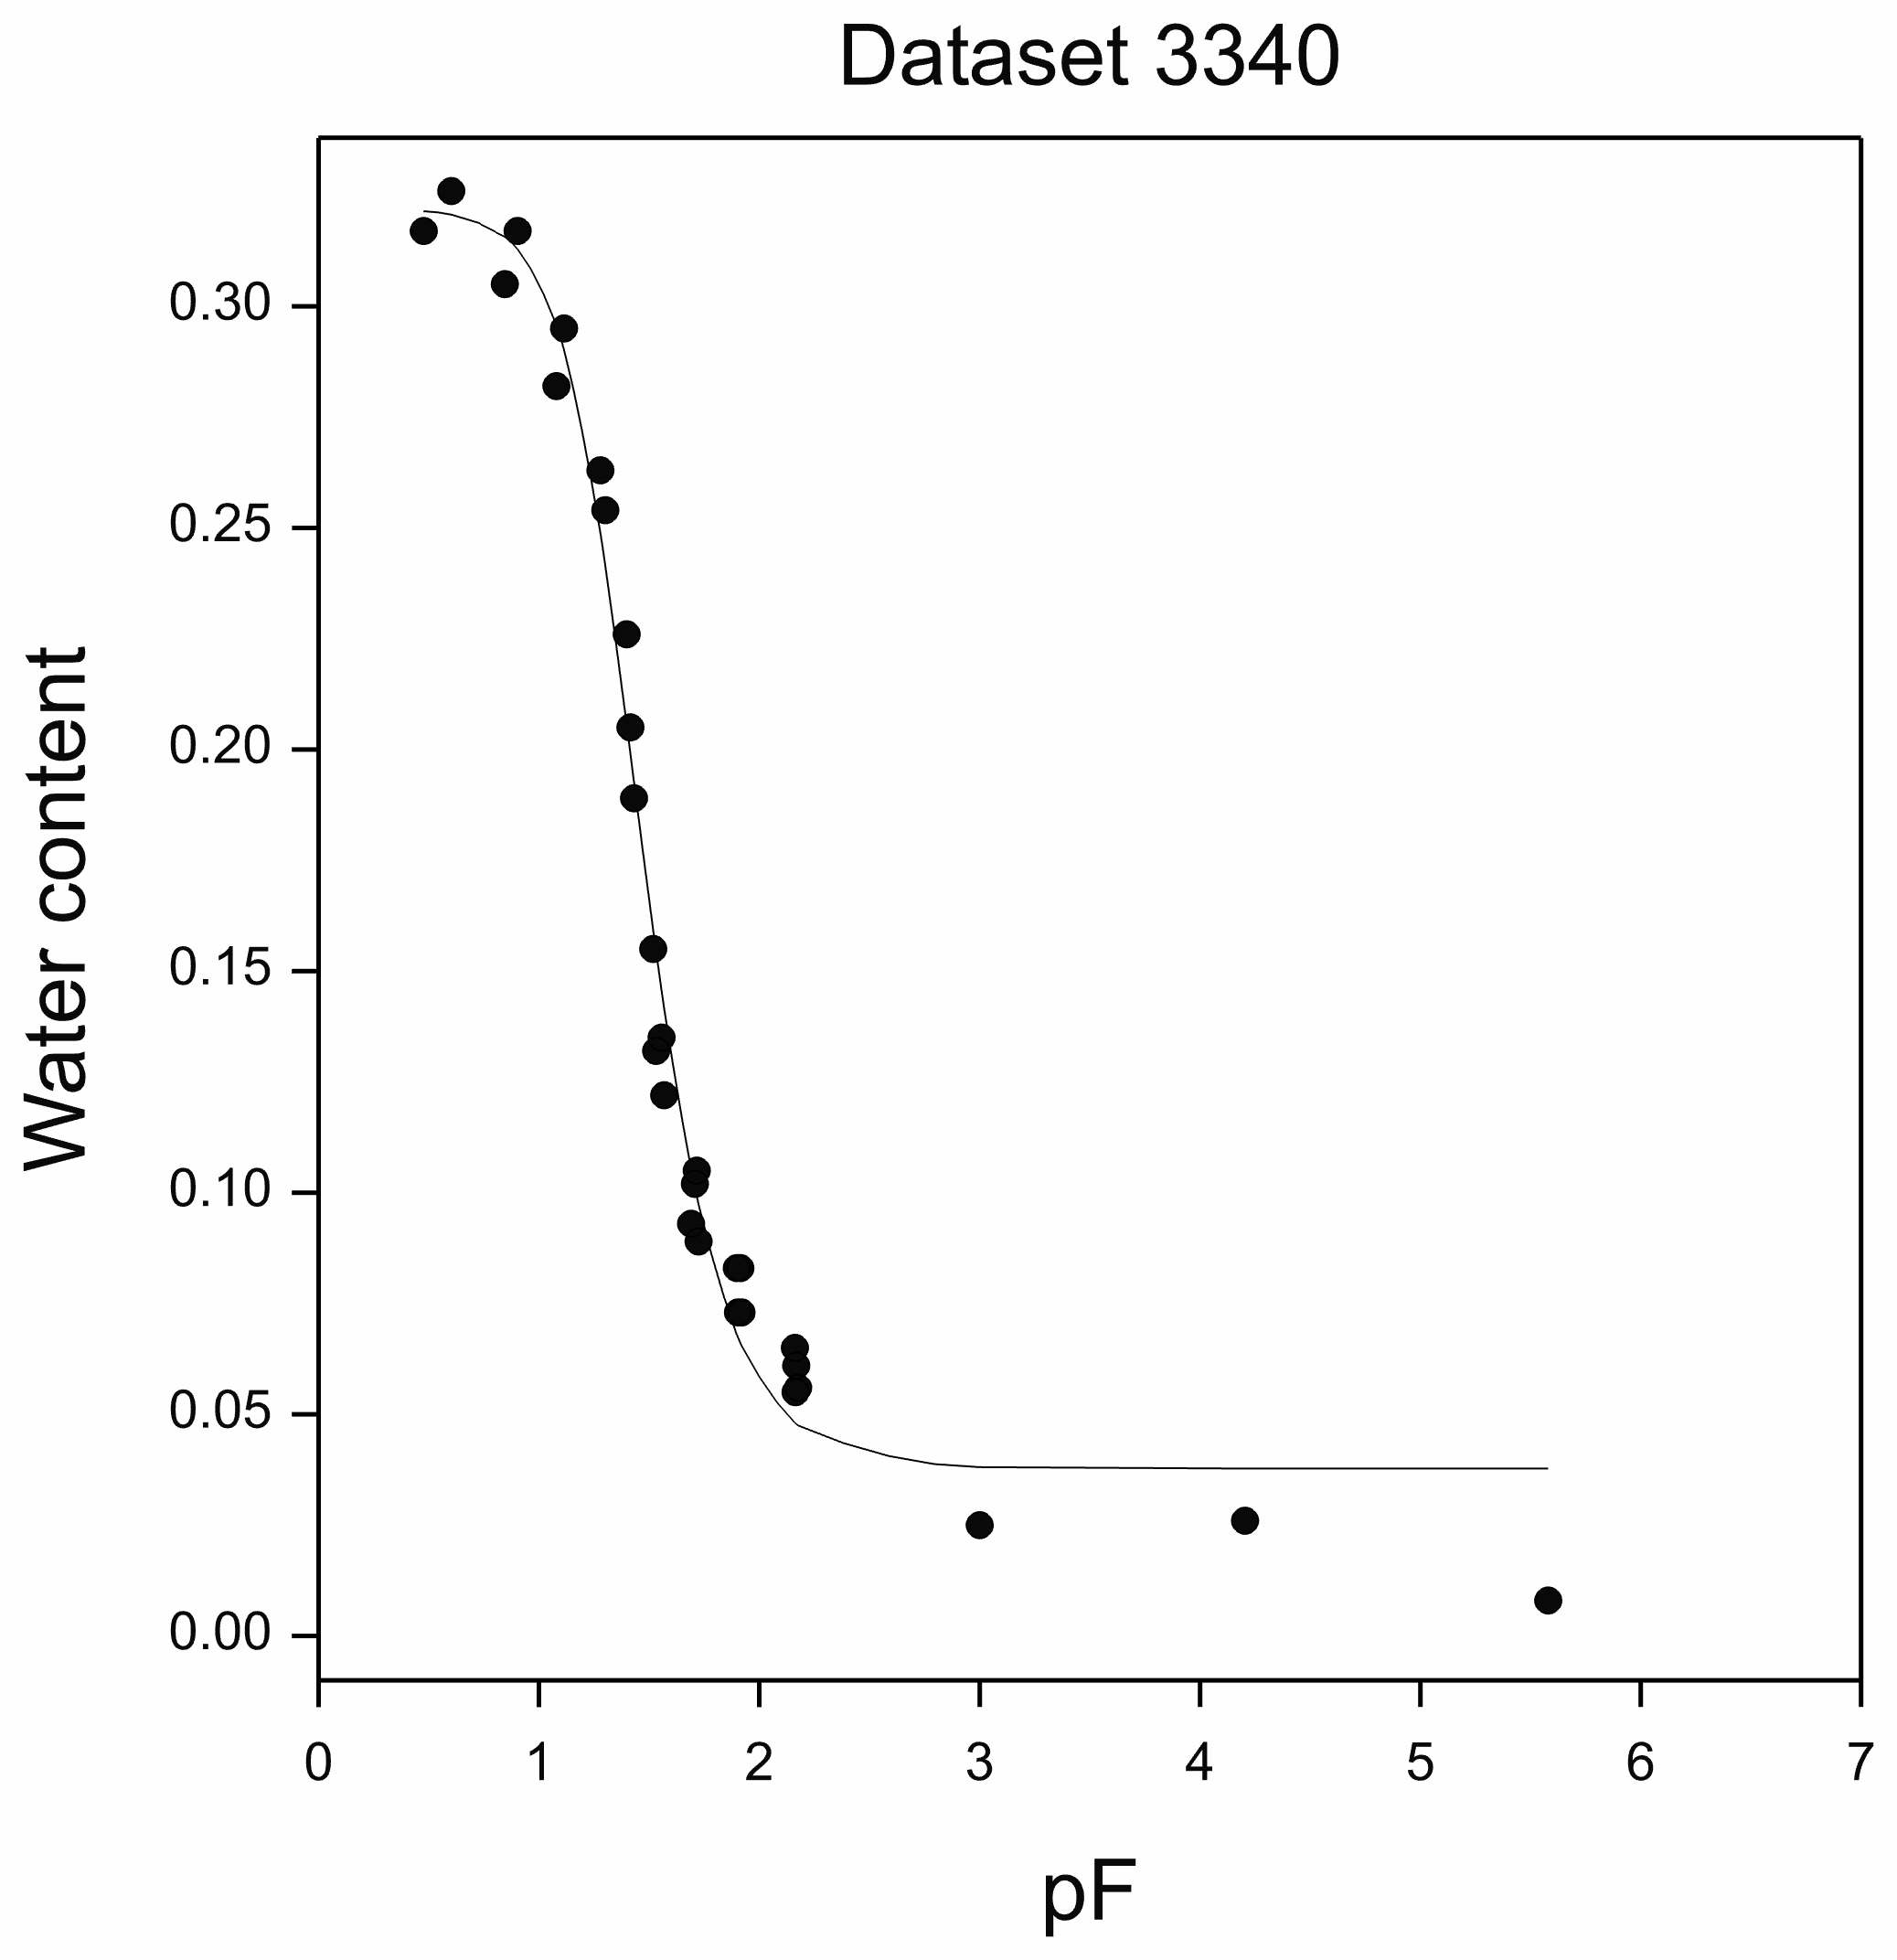
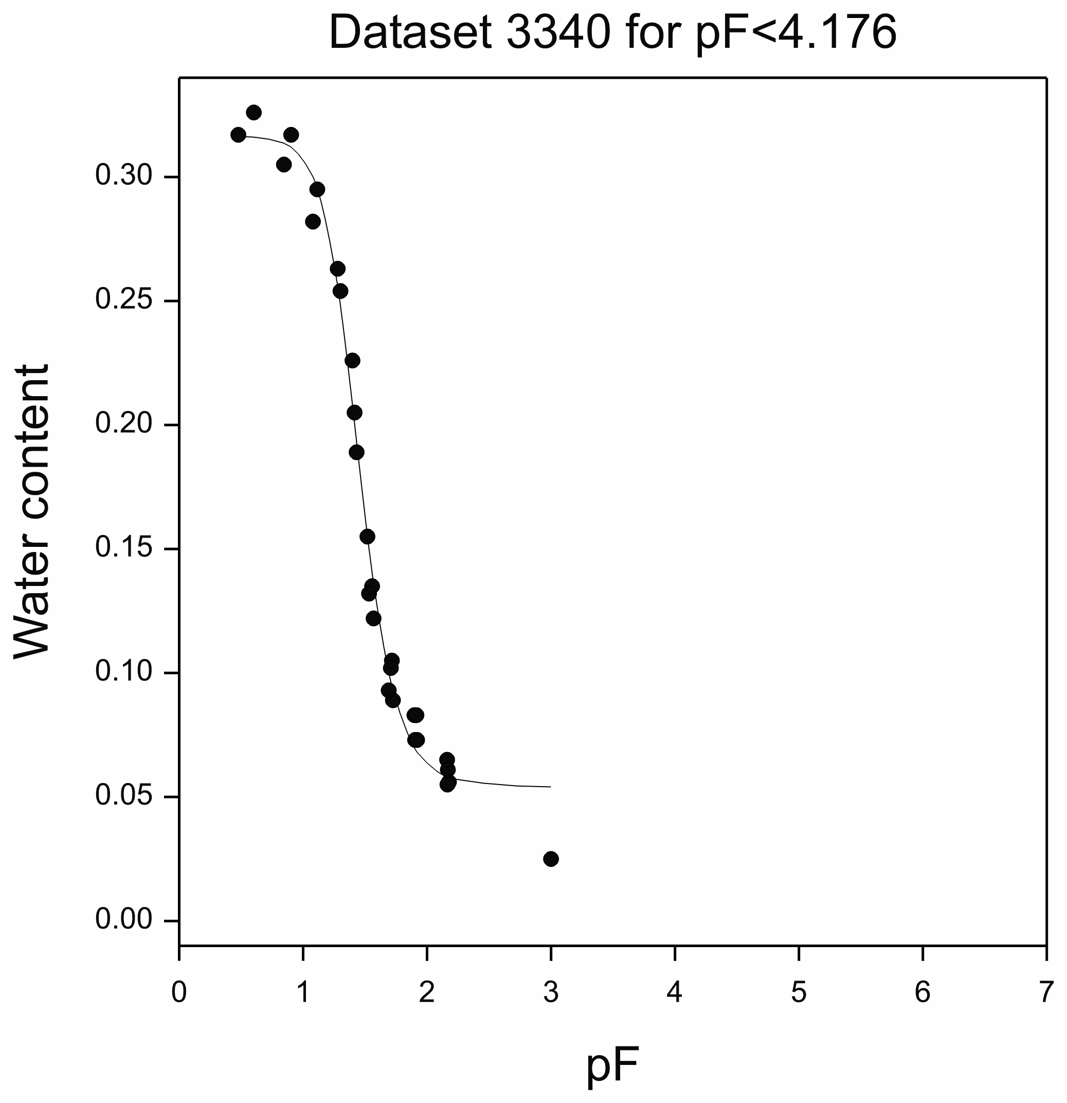
Relationships over the Full Soil Moisture Range
UNSODA DATASETS
Sand

Slide 27
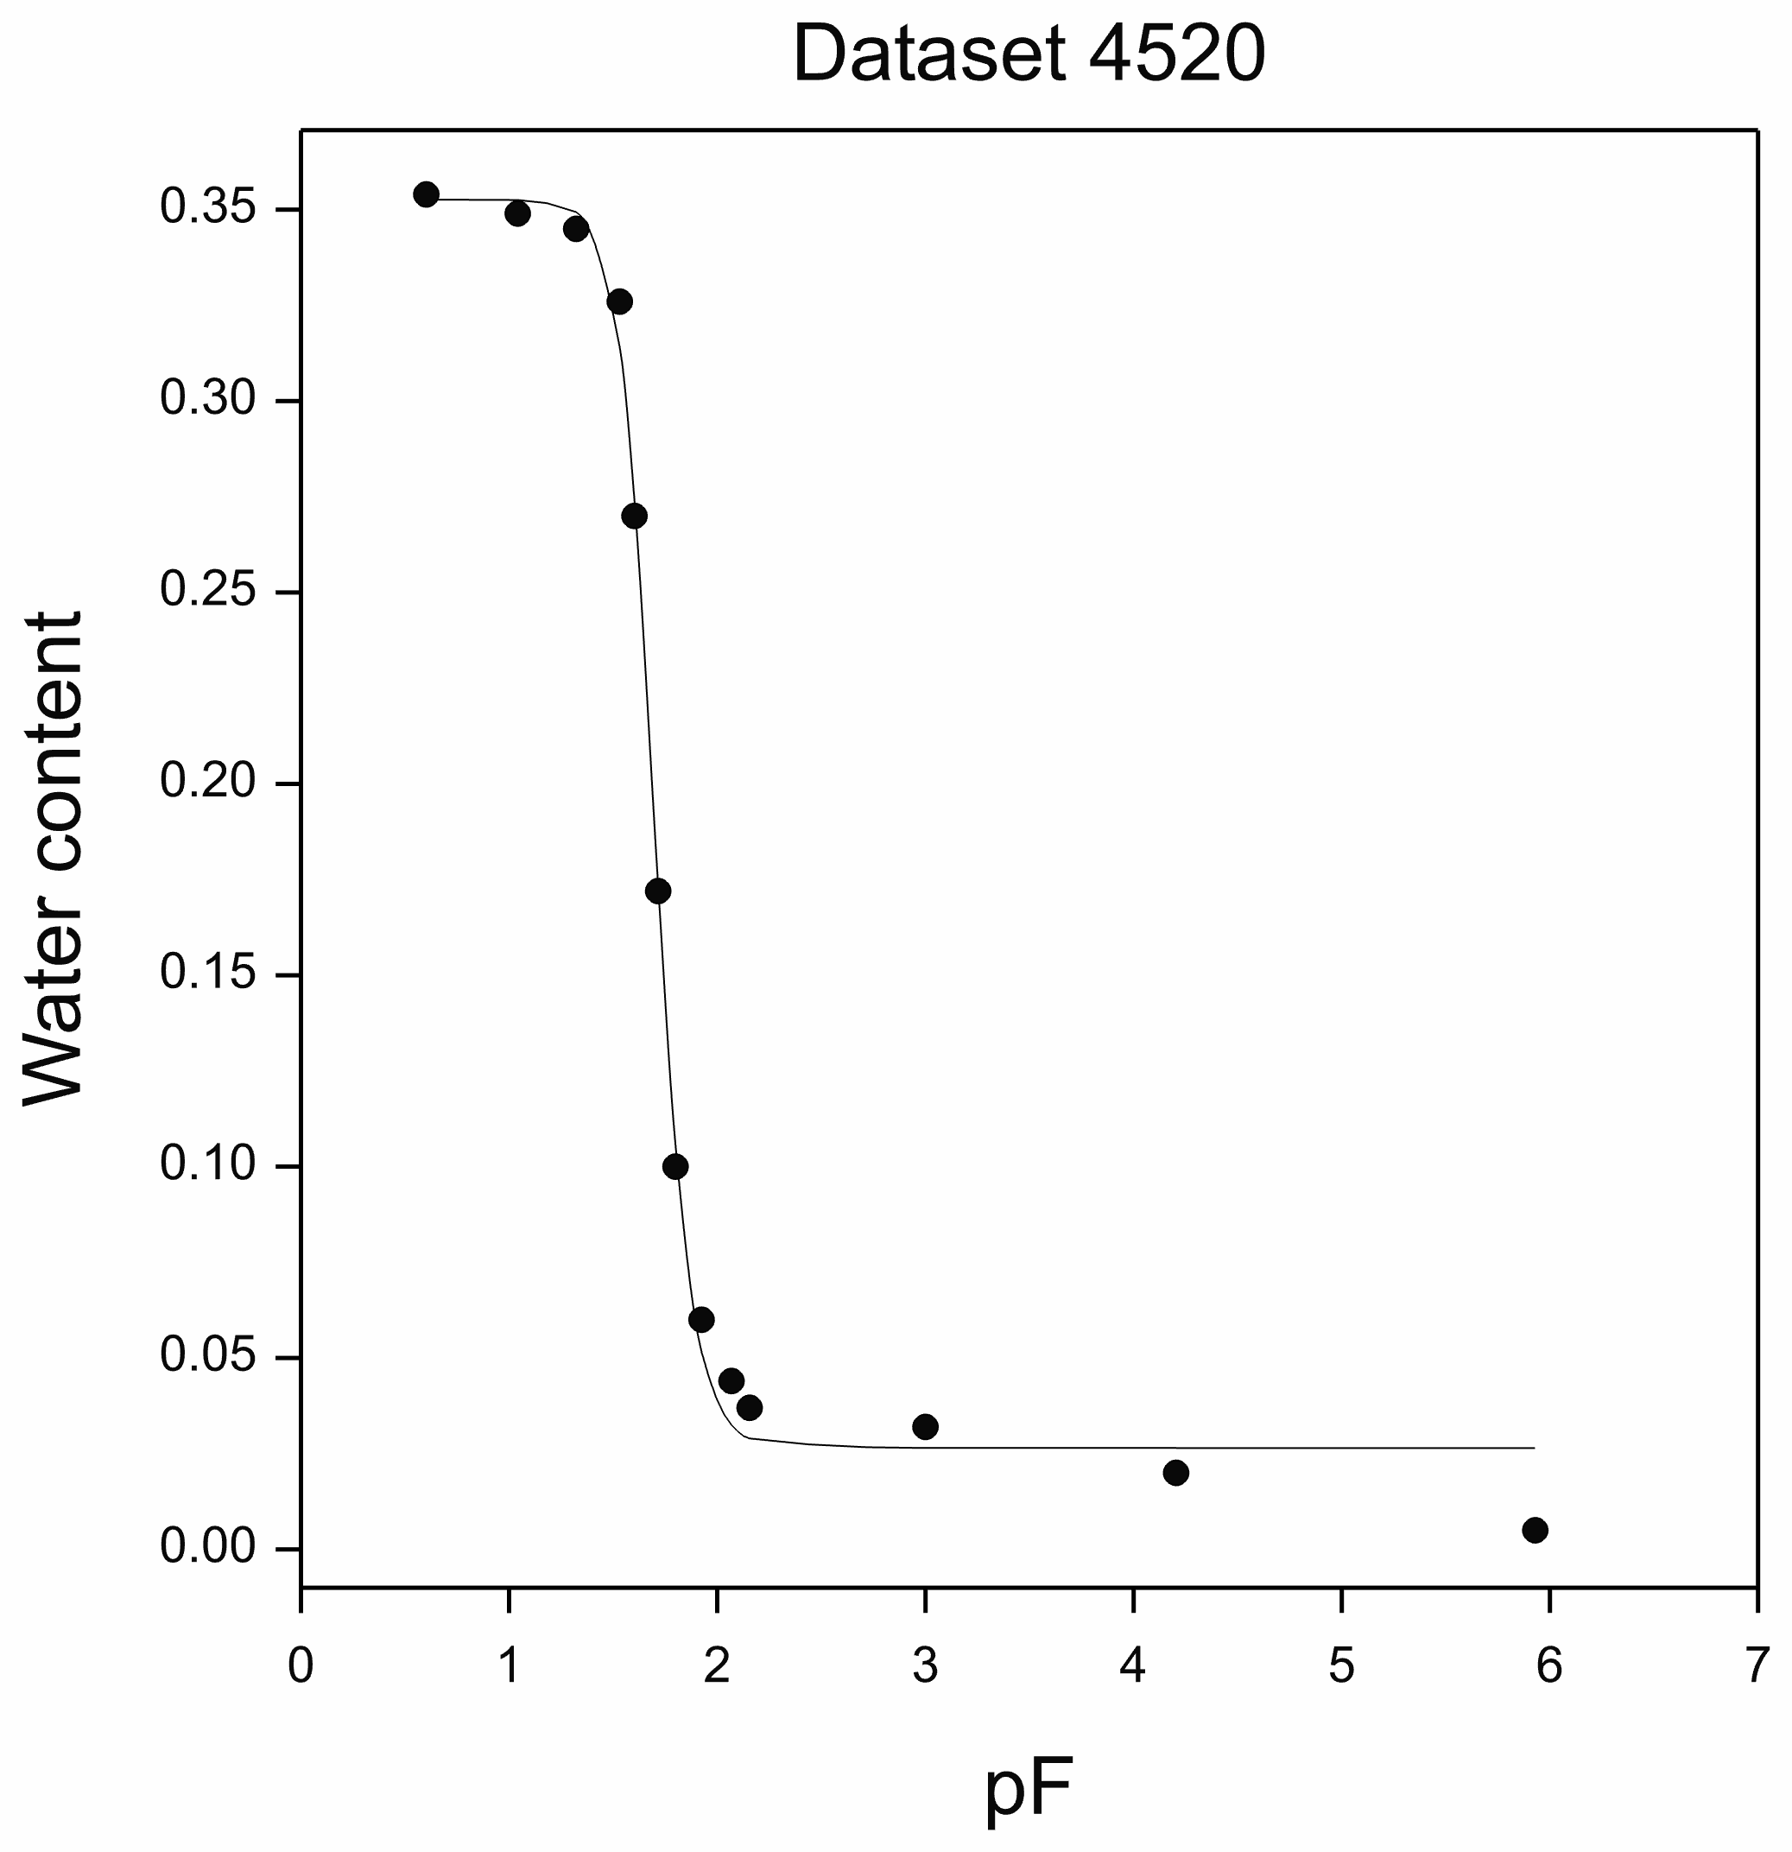
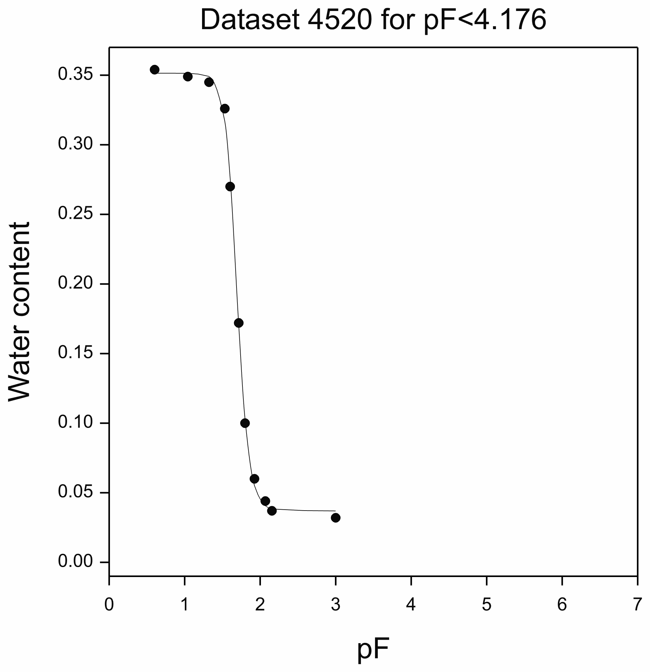
Relationships over the Full Soil Moisture Range
UNSODA DATASETS
Sand

Slide 28
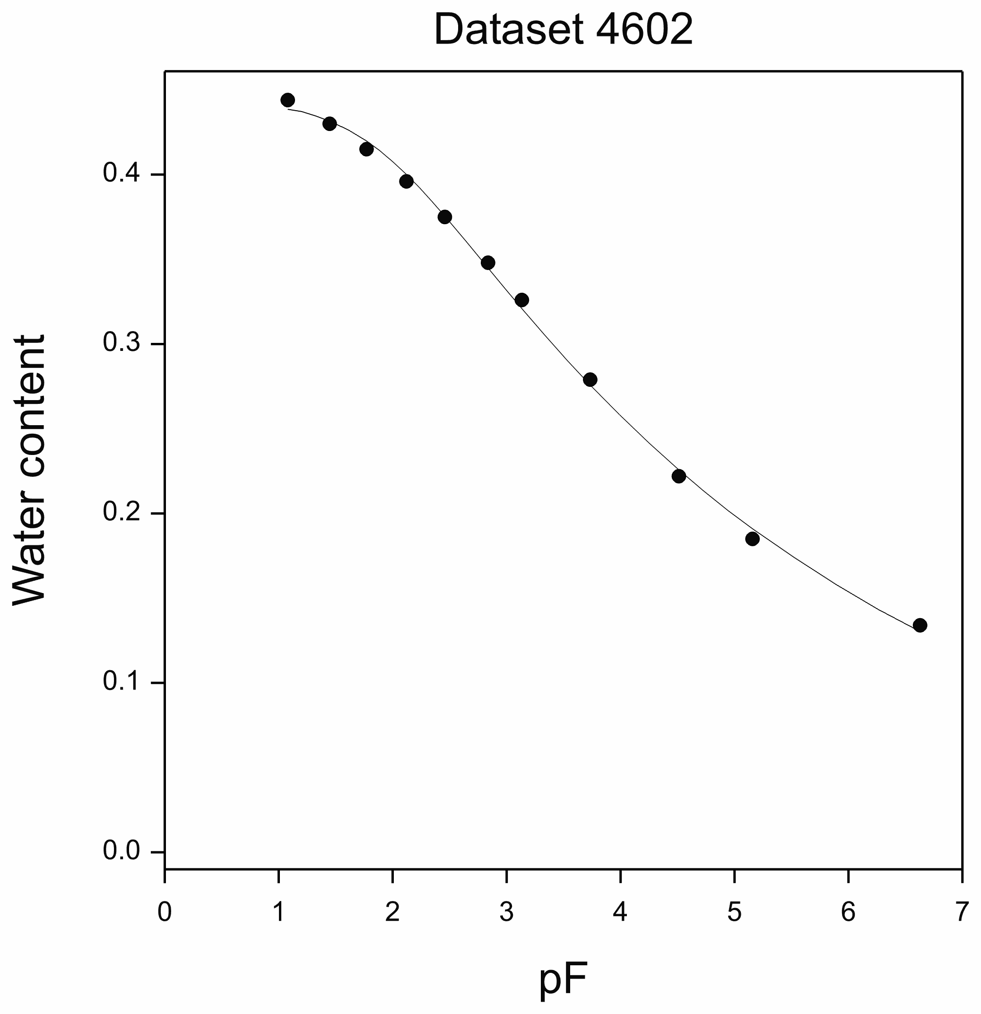
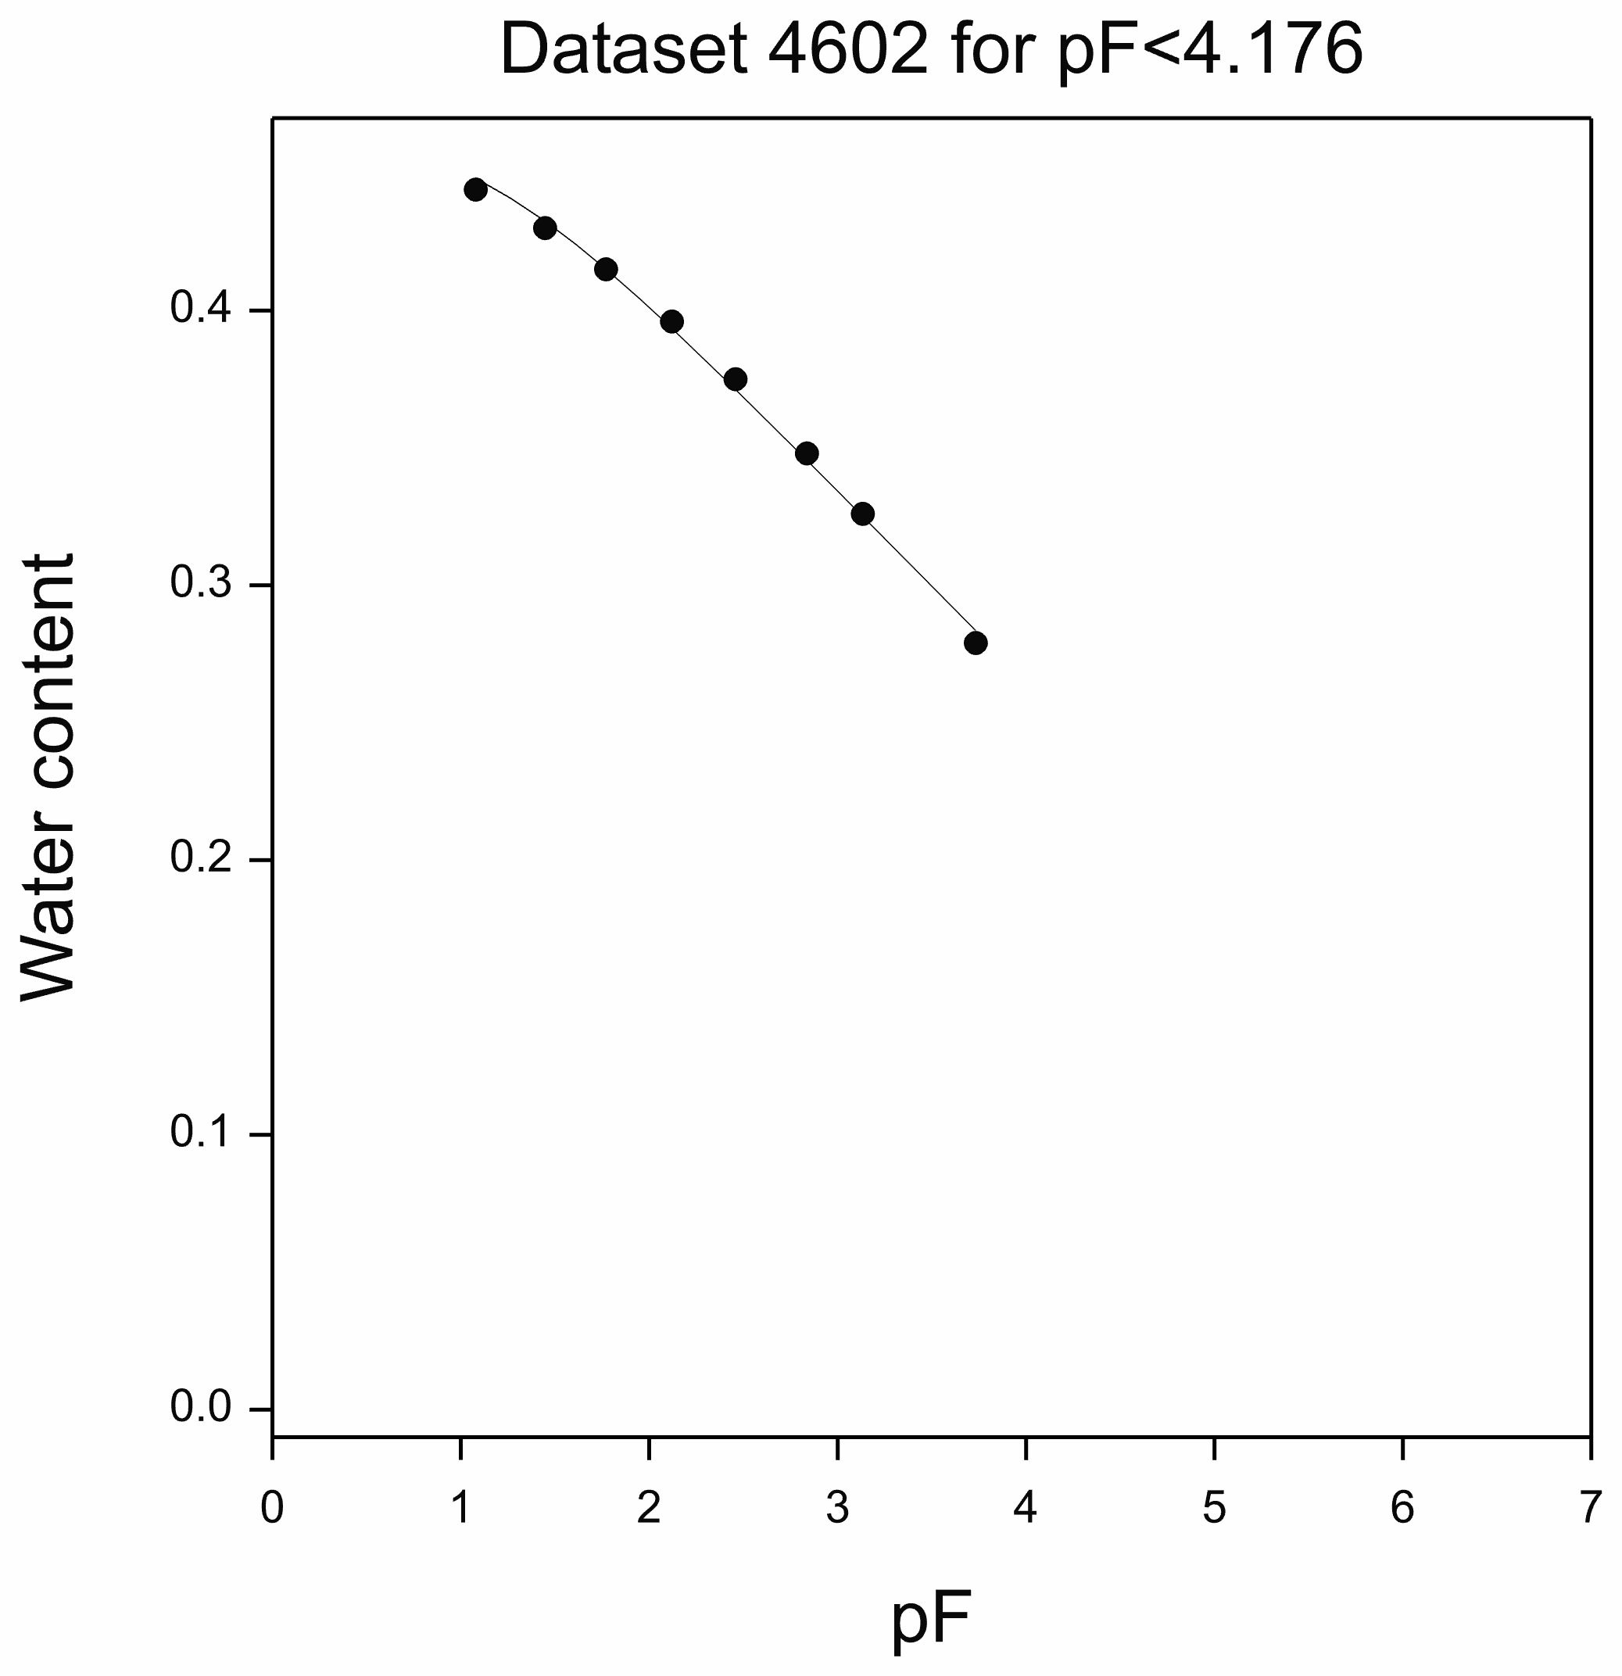
Relationships over the Full Soil Moisture Range
UNSODA DATASETS
Sandy clay loam

Slide 29
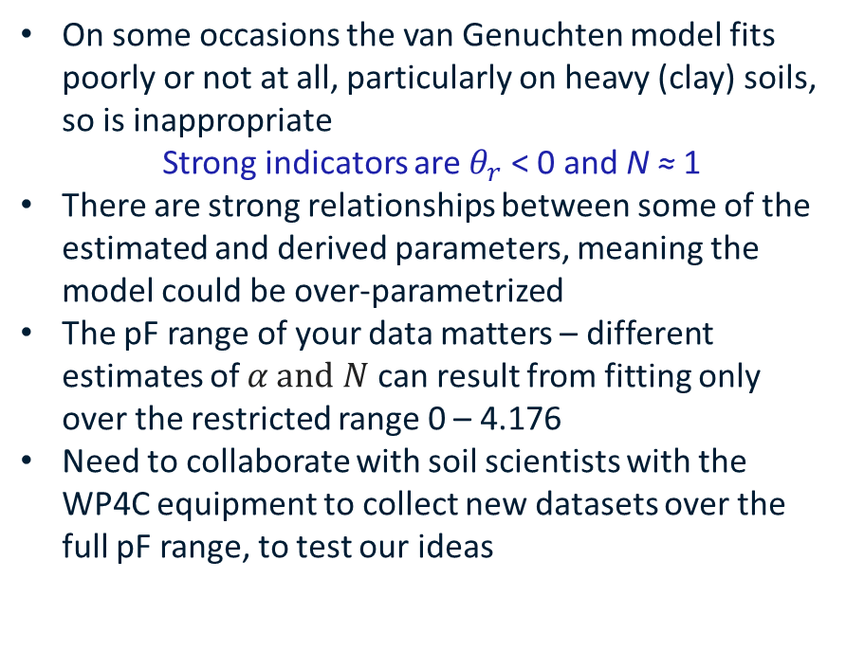
Conclusions 1
On some occasions the van Genuchten model fits poorly or not at all, particularly on heavy (clay) soils, so is inappropriate
Strong indicators are $θ_{r}$ < 0 and N ≈ 1
There are strong relationships between some of the estimated and derived parameters, meaning the model could be over-parametrized
The pF range of your data matters – different estimates of $α and$ $N$ can result from fitting only over the restricted range 0 – 4.176
Need to collaborate with soil scientists with the WP4C equipment to collect new datasets over the full pF range, to test our ideas

Slide 30
Conclusions 2
Why are we fitting a model?
Parameters of the model have physical meaning
Fitted parameter values may be used for further modelling
Fitted parameters could summarise the response
Getting correct parameter estimates over the full range is important
Want interpolation for new VWC values which don’t correspond to a pF value
Need the best model over the range for interpolation
Doesn’t matter if the model is van Genuchten or anything else
Smooth visual representation of response
Can find the best model over a range of non-linear models
If no parametric model is adequate, spline fitting may be all that is needed

Slide 31
References
Brady, N.C. and Weil, R.R. 2002 The Nature and Properties of Soils. 13th Edition, Pearson Education, Inc., Upper Saddle River, 960.
Campbell, G.S. and Shiozawa,S 1992 Prediction of hydraulic properties of soils using particle-size distribution and bulk density data. In: International Workshop on Indirect Methods for Estimating the Hydraulic Properties of Unsaturated Soils (1989 : Riverside, Calif.) M.T. van Genuchten F. J Leij L. J Lund (Lanny J.) 1992
Elements of Soil Physics 1983 Ed. by P. Koorevaar, G. Menelik, C. Dirksen. Elsevier Science B.V., Amsterdam, The Netherlands
Ross, P.J., Williams, J. and Bristow, K.L. 1991 Equation for Extending Water-Retention Curves to Dryness. Soil Science Society America J. 55, 923-927.
UNSODA: The UNSODA Unsaturated Soil Hydraulic Database. Version 2.0. A. Nemes, M. Schaap and F. Leij. U.S. Salinity Laboratory, Riverside, USA
Van Genuchten M Th. 1980 A Closed-form Equation for Predicting the Hydraulic Conductivity of Unsaturated Soils. Soil Science Society America J. 44, 892-898.

Slide 32
Thank you
Environment
Warren Müller
+61 2 6246 4187
warren.muller@csiro.au
https://www.csiro.au/en/

